Slide 1
A Level Biology – Open Evening Presentation

Slide 2
Why should I pick King Edward’s?
One of the best performing 6th forms in Staffordshire for many years
29 courses offered at A Level
2022, 2019, 2018 – 100% Pass rate in A Level Biology
2022 – 72% A* - C
2019 – 66% A*-C
2018 – 67% A* - C

Slide 3
Why should I pick King Edward’s?
2023 Exam Results
91% Pass rate in A Level Biology
21.5% A* - A
37% A* - B
52.9% A* - C
80% of students achieved a D or above

Slide 4
Who should study A Level Biology?
Interest in studying living organisms
Interest in how the planet is changing and the impact we are having
Interest in the spread and cure of infectious disease
Interest in genetics and evolution

Slide 5
Why should I pick A Level Biology?
Highly respected course
Transferrable skills
Data analysis, statistics, extended writing, problem solving, evaluation, ethical discussion
Opportunity to practice practical skills
Team work
Enjoyable and varied content
Notes:
Review end of topic assessments:
- Currently are not fit for purpose
- Write our own assessments with a higher total mark
- Include one question per assessment which focusses on a previous topic
Order of Teaching:
- Create a curriculum map, outlining the assessment points and expected completion dates
- Allow time for proper study of the required pracitcals
- Allow time for the proper study of Maths in Biology
Intervention :
- Review current working-at grades for students
- Identify those who are not achieving target grade and invite them for intervention in September

Slide 6
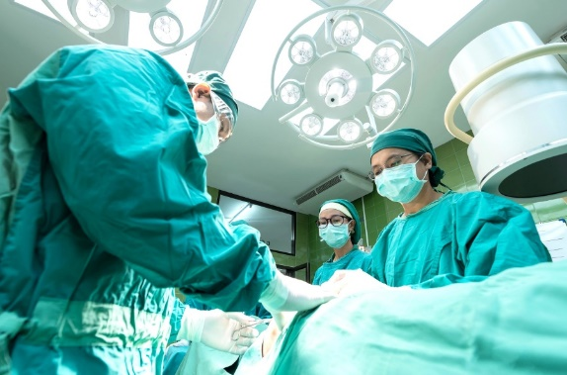
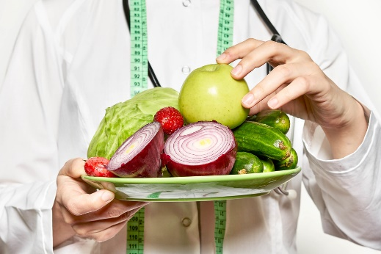
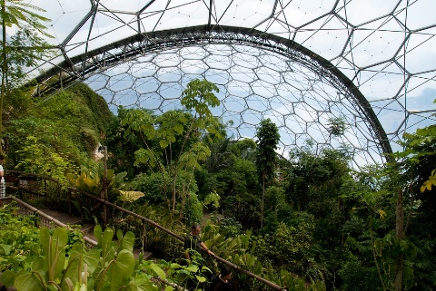
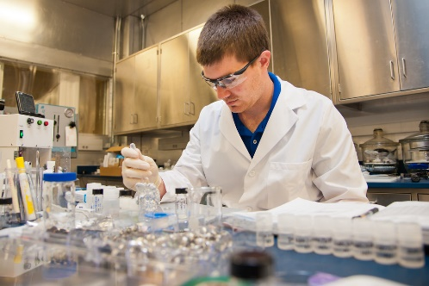
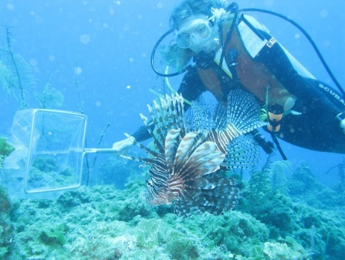
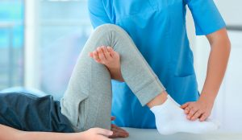
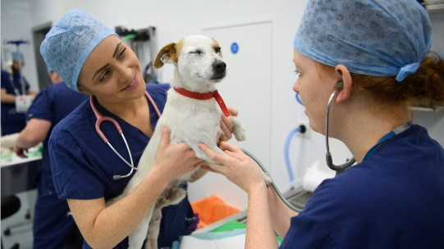
Where can A Level Biology take me?
Paramedic
Vaccine and Medicine development
Doctor, Nurse, Midwife, Surgeon
Nutritionist, Dietician, Health and Wellbeing
Botanist, Resources from plants
Alternative energy and food resources
Research
Conservation, ecology, marine-biology
Physiotherapy, Occupational Therapy, Rehabilitation
Veterinary Science
Notes:
Review end of topic assessments:
- Currently are not fit for purpose
- Write our own assessments with a higher total mark
- Include one question per assessment which focusses on a previous topic
Order of Teaching:
- Create a curriculum map, outlining the assessment points and expected completion dates
- Allow time for proper study of the required pracitcals
- Allow time for the proper study of Maths in Biology
Intervention :
- Review current working-at grades for students
- Identify those who are not achieving target grade and invite them for intervention in September

Slide 7
What topics will I study?
Year 1
Biological Molecules
Immune System
Mass Transport in Animals and Plants
Cell Structure
Cell Membranes
DNA,RNA and Proteinsynthesis
Diversity, Classification and Variation
Year 2
Photosynthesis
Nutrient Cycles
Ecosystems
Muscle Contraction Homeostasis
Respiration
Nervous Response
Inheritance and Genetics
Genomes and Evolution

Slide 8
How will I be assessed?
Paper 1
2 hour exam
91 marks (35%)
Year 1 content
Paper 2
2 hour exam
91 marks (35%)
Year 2 content
Paper 3
2 hour exam
78 marks (30%)
All content
25 mark Essay
Notes:
Review end of topic assessments:
- Currently are not fit for purpose
- Write our own assessments with a higher total mark
- Include one question per assessment which focusses on a previous topic
Order of Teaching:
- Create a curriculum map, outlining the assessment points and expected completion dates
- Allow time for proper study of the required pracitcals
- Allow time for the proper study of Maths in Biology
Intervention :
- Review current working-at grades for students
- Identify those who are not achieving target grade and invite them for intervention in September

Slide 9
The Teaching Team
2 Specialist Teachers per class
Miss Shaw – Head of Biology
Mr Hensley
Mrs Ridgway – Year 6 Transition Coordinator
Mr Tyler
Mrs Hardy (maternity leave)
Mr Durant
Mr Gohil

Slide 10
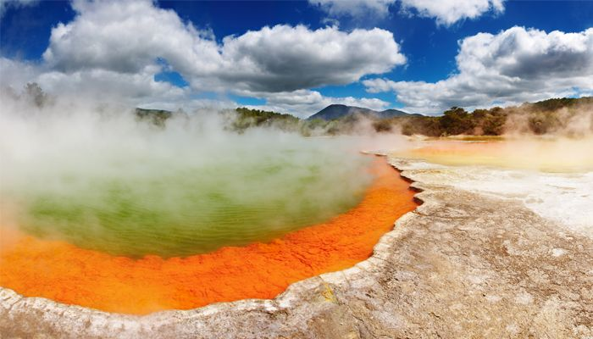
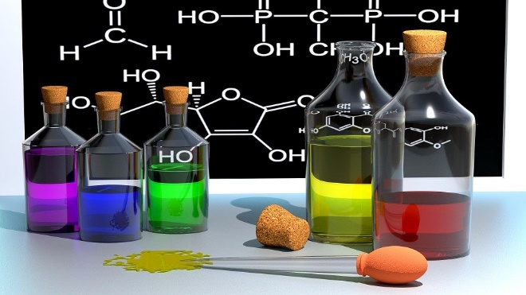
Which subjects does A Level Biology compliment?
Overlap in content and skills with lots of subjects:
Psychology
Geography
Chemistry
Physical Education
Notes:
Review end of topic assessments:
- Currently are not fit for purpose
- Write our own assessments with a higher total mark
- Include one question per assessment which focusses on a previous topic
Order of Teaching:
- Create a curriculum map, outlining the assessment points and expected completion dates
- Allow time for proper study of the required pracitcals
- Allow time for the proper study of Maths in Biology
Intervention :
- Review current working-at grades for students
- Identify those who are not achieving target grade and invite them for intervention in September

Slide 11
What are the entry requirements?
Triple Biology :
6 in Biology, plus another 6 from Science (preferably Chemistry).
Combined Science :
6-6 Overall, with a 6 from the Biology Paper and 6 from another (preferably Chemistry)
Maths Requirement:
All students will need a Grade 5 from Maths off the Higher Tier paper.
Notes:
Review end of topic assessments:
- Currently are not fit for purpose
- Write our own assessments with a higher total mark
- Include one question per assessment which focusses on a previous topic
Order of Teaching:
- Create a curriculum map, outlining the assessment points and expected completion dates
- Allow time for proper study of the required pracitcals
- Allow time for the proper study of Maths in Biology
Intervention :
- Review current working-at grades for students
- Identify those who are not achieving target grade and invite them for intervention in September

Slide 12
How do I know if this is the right course for me?
Excited and passionate about Science, specifically Biology
Determination and drive to learn and succeed
Enjoys learning about and is enthusiastic about the living world
Feels that they are willing to put in extra work without it being a burden

Slide 13
What if I’m still unsure?
Speak to your teachers and parents
Speak to Year 12 &13 students
Research potential careers and UCAS requirements
Book an appointment with the careers advisor
Notes:
Review end of topic assessments:
- Currently are not fit for purpose
- Write our own assessments with a higher total mark
- Include one question per assessment which focusses on a previous topic
Order of Teaching:
- Create a curriculum map, outlining the assessment points and expected completion dates
- Allow time for proper study of the required pracitcals
- Allow time for the proper study of Maths in Biology
Intervention :
- Review current working-at grades for students
- Identify those who are not achieving target grade and invite them for intervention in September

Slide 14
Questions?
Thank-you for your interest in A Level Biology at King Edward’s Lichfield.
We hope to see you next September

Slide 15
Welcome to Biology
The next presentation will start soon.

Slide 16
A Level Biology – Open Evening Presentation

Slide 17
Why should I pick King Edward’s?
One of the best performing 6th forms in Staffordshire for many years
29 courses offered at A Level
2022, 2019, 2018 – 100% Pass rate in A Level Biology
2022 – 72% A* - C
2019 – 66% A*-C
2018 – 67% A* - C

Slide 18
Why should I pick King Edward’s?
2023 Exam Results
91% Pass rate in A Level Biology
21.5% A* - A
37% A* - B
52.9% A* - C
80% of students achieved a D or above

Slide 19
Who should study A Level Biology?
Interest in studying living organisms
Interest in how the planet is changing and the impact we are having
Interest in the spread and cure of infectious disease
Interest in genetics and evolution

Slide 20
Why should I pick A Level Biology?
Highly respected course
Transferrable skills
Data analysis, statistics, extended writing, problem solving, evaluation, ethical discussion
Opportunity to practice practical skills
Team work
Enjoyable and varied content
Notes:
Review end of topic assessments:
- Currently are not fit for purpose
- Write our own assessments with a higher total mark
- Include one question per assessment which focusses on a previous topic
Order of Teaching:
- Create a curriculum map, outlining the assessment points and expected completion dates
- Allow time for proper study of the required pracitcals
- Allow time for the proper study of Maths in Biology
Intervention :
- Review current working-at grades for students
- Identify those who are not achieving target grade and invite them for intervention in September

Slide 21
Where can A Level Biology take me?
Paramedic
Vaccine and Medicine development
Doctor, Nurse, Midwife, Surgeon
Nutritionist, Dietician, Health and Wellbeing
Botanist, Resources from plants
Alternative energy and food resources
Research
Conservation, ecology, marine-biology
Physiotherapy, Occupational Therapy, Rehabilitation
Veterinary Science
Notes:
Review end of topic assessments:
- Currently are not fit for purpose
- Write our own assessments with a higher total mark
- Include one question per assessment which focusses on a previous topic
Order of Teaching:
- Create a curriculum map, outlining the assessment points and expected completion dates
- Allow time for proper study of the required pracitcals
- Allow time for the proper study of Maths in Biology
Intervention :
- Review current working-at grades for students
- Identify those who are not achieving target grade and invite them for intervention in September

Slide 22
What topics will I study?
Year 1
Biological Molecules
Immune System
Mass Transport in Animals and Plants
Cell Structure
Cell Membranes
DNA,RNA and Proteinsynthesis
Diversity, Classification and Variation
Year 2
Photosynthesis
Nutrient Cycles
Ecosystems
Muscle Contraction Homeostasis
Respiration
Nervous Response
Inheritance and Genetics
Genomes and Evolution

Slide 23
How will I be assessed?
Paper 1
2 hour exam
91 marks (35%)
Year 1 content
Paper 2
2 hour exam
91 marks (35%)
Year 2 content
Paper 3
2 hour exam
78 marks (30%)
All content
25 mark Essay
Notes:
Review end of topic assessments:
- Currently are not fit for purpose
- Write our own assessments with a higher total mark
- Include one question per assessment which focusses on a previous topic
Order of Teaching:
- Create a curriculum map, outlining the assessment points and expected completion dates
- Allow time for proper study of the required pracitcals
- Allow time for the proper study of Maths in Biology
Intervention :
- Review current working-at grades for students
- Identify those who are not achieving target grade and invite them for intervention in September

Slide 24
The Teaching Team
2 Specialist Teachers per class
Miss Shaw – Head of Biology
Mr Hensley
Mrs Ridgway – Year 6 Transition Coordinator
Mr Tyler
Mrs Hardy (maternity leave)
Mr Durant
Mr Gohil

Slide 25
Which subjects does A Level Biology compliment?
Overlap in content and skills with lots of subjects:
Psychology
Geography
Chemistry
Physical Education
Notes:
Review end of topic assessments:
- Currently are not fit for purpose
- Write our own assessments with a higher total mark
- Include one question per assessment which focusses on a previous topic
Order of Teaching:
- Create a curriculum map, outlining the assessment points and expected completion dates
- Allow time for proper study of the required pracitcals
- Allow time for the proper study of Maths in Biology
Intervention :
- Review current working-at grades for students
- Identify those who are not achieving target grade and invite them for intervention in September

Slide 26
What are the entry requirements?
Triple Biology :
6 in Biology, plus another 6 from Science (preferably Chemistry).
Combined Science :
6-6 Overall, with a 6 from the Biology Paper and 6 from another (preferably Chemistry)
Maths Requirement:
All students will need a Grade 5 from Maths off the Higher Tier paper.
Notes:
Review end of topic assessments:
- Currently are not fit for purpose
- Write our own assessments with a higher total mark
- Include one question per assessment which focusses on a previous topic
Order of Teaching:
- Create a curriculum map, outlining the assessment points and expected completion dates
- Allow time for proper study of the required pracitcals
- Allow time for the proper study of Maths in Biology
Intervention :
- Review current working-at grades for students
- Identify those who are not achieving target grade and invite them for intervention in September

Slide 27
How do I know if this is the right course for me?
Excited and passionate about Science, specifically Biology
Determination and drive to learn and succeed
Enjoys learning about and is enthusiastic about the living world
Feels that they are willing to put in extra work without it being a burden

Slide 28
What if I’m still unsure?
Speak to your teachers and parents
Speak to Year 12 &13 students
Research potential careers and UCAS requirements
Book an appointment with the careers advisor
Notes:
Review end of topic assessments:
- Currently are not fit for purpose
- Write our own assessments with a higher total mark
- Include one question per assessment which focusses on a previous topic
Order of Teaching:
- Create a curriculum map, outlining the assessment points and expected completion dates
- Allow time for proper study of the required pracitcals
- Allow time for the proper study of Maths in Biology
Intervention :
- Review current working-at grades for students
- Identify those who are not achieving target grade and invite them for intervention in September

Slide 29
Questions?
Thank-you for your interest in A Level Biology at King Edward’s Lichfield.
We hope to see you next September

Slide 30
Welcome to Biology
The next presentation will start soon.

Slide 31
A Level Biology – Open Evening Presentation

Slide 32
Why should I pick King Edward’s?
One of the best performing 6th forms in Staffordshire for many years
29 courses offered at A Level
2022, 2019, 2018 – 100% Pass rate in A Level Biology
2022 – 72% A* - C
2019 – 66% A*-C
2018 – 67% A* - C

Slide 33
Why should I pick King Edward’s?
2023 Exam Results
91% Pass rate in A Level Biology
21.5% A* - A
37% A* - B
52.9% A* - C
80% of students achieved a D or above

Slide 34
Who should study A Level Biology?
Interest in studying living organisms
Interest in how the planet is changing and the impact we are having
Interest in the spread and cure of infectious disease
Interest in genetics and evolution

Slide 35
Why should I pick A Level Biology?
Highly respected course
Transferrable skills
Data analysis, statistics, extended writing, problem solving, evaluation, ethical discussion
Opportunity to practice practical skills
Team work
Enjoyable and varied content
Notes:
Review end of topic assessments:
- Currently are not fit for purpose
- Write our own assessments with a higher total mark
- Include one question per assessment which focusses on a previous topic
Order of Teaching:
- Create a curriculum map, outlining the assessment points and expected completion dates
- Allow time for proper study of the required pracitcals
- Allow time for the proper study of Maths in Biology
Intervention :
- Review current working-at grades for students
- Identify those who are not achieving target grade and invite them for intervention in September

Slide 36
Where can A Level Biology take me?
Paramedic
Vaccine and Medicine development
Doctor, Nurse, Midwife, Surgeon
Nutritionist, Dietician, Health and Wellbeing
Botanist, Resources from plants
Alternative energy and food resources
Research
Conservation, ecology, marine-biology
Physiotherapy, Occupational Therapy, Rehabilitation
Veterinary Science
Notes:
Review end of topic assessments:
- Currently are not fit for purpose
- Write our own assessments with a higher total mark
- Include one question per assessment which focusses on a previous topic
Order of Teaching:
- Create a curriculum map, outlining the assessment points and expected completion dates
- Allow time for proper study of the required pracitcals
- Allow time for the proper study of Maths in Biology
Intervention :
- Review current working-at grades for students
- Identify those who are not achieving target grade and invite them for intervention in September

Slide 37
What topics will I study?
Year 1
Biological Molecules
Immune System
Mass Transport in Animals and Plants
Cell Structure
Cell Membranes
DNA,RNA and Proteinsynthesis
Diversity, Classification and Variation
Year 2
Photosynthesis
Nutrient Cycles
Ecosystems
Muscle Contraction Homeostasis
Respiration
Nervous Response
Inheritance and Genetics
Genomes and Evolution

Slide 38
How will I be assessed?
Paper 1
2 hour exam
91 marks (35%)
Year 1 content
Paper 2
2 hour exam
91 marks (35%)
Year 2 content
Paper 3
2 hour exam
78 marks (30%)
All content
25 mark Essay
Notes:
Review end of topic assessments:
- Currently are not fit for purpose
- Write our own assessments with a higher total mark
- Include one question per assessment which focusses on a previous topic
Order of Teaching:
- Create a curriculum map, outlining the assessment points and expected completion dates
- Allow time for proper study of the required pracitcals
- Allow time for the proper study of Maths in Biology
Intervention :
- Review current working-at grades for students
- Identify those who are not achieving target grade and invite them for intervention in September

Slide 39
The Teaching Team
2 Specialist Teachers per class
Miss Shaw – Head of Biology
Mr Hensley
Mrs Ridgway – Year 6 Transition Coordinator
Mr Tyler
Mrs Hardy (maternity leave)
Mr Durant
Mr Gohil

Slide 40
Which subjects does A Level Biology compliment?
Overlap in content and skills with lots of subjects:
Psychology
Geography
Chemistry
Physical Education
Notes:
Review end of topic assessments:
- Currently are not fit for purpose
- Write our own assessments with a higher total mark
- Include one question per assessment which focusses on a previous topic
Order of Teaching:
- Create a curriculum map, outlining the assessment points and expected completion dates
- Allow time for proper study of the required pracitcals
- Allow time for the proper study of Maths in Biology
Intervention :
- Review current working-at grades for students
- Identify those who are not achieving target grade and invite them for intervention in September

Slide 41
What are the entry requirements?
Triple Biology :
6 in Biology, plus another 6 from Science (preferably Chemistry).
Combined Science :
6-6 Overall, with a 6 from the Biology Paper and 6 from another (preferably Chemistry)
Maths Requirement:
All students will need a Grade 5 from Maths off the Higher Tier paper.
Notes:
Review end of topic assessments:
- Currently are not fit for purpose
- Write our own assessments with a higher total mark
- Include one question per assessment which focusses on a previous topic
Order of Teaching:
- Create a curriculum map, outlining the assessment points and expected completion dates
- Allow time for proper study of the required pracitcals
- Allow time for the proper study of Maths in Biology
Intervention :
- Review current working-at grades for students
- Identify those who are not achieving target grade and invite them for intervention in September

Slide 42
How do I know if this is the right course for me?
Excited and passionate about Science, specifically Biology
Determination and drive to learn and succeed
Enjoys learning about and is enthusiastic about the living world
Feels that they are willing to put in extra work without it being a burden

Slide 43
What if I’m still unsure?
Speak to your teachers and parents
Speak to Year 12 &13 students
Research potential careers and UCAS requirements
Book an appointment with the careers advisor
Notes:
Review end of topic assessments:
- Currently are not fit for purpose
- Write our own assessments with a higher total mark
- Include one question per assessment which focusses on a previous topic
Order of Teaching:
- Create a curriculum map, outlining the assessment points and expected completion dates
- Allow time for proper study of the required pracitcals
- Allow time for the proper study of Maths in Biology
Intervention :
- Review current working-at grades for students
- Identify those who are not achieving target grade and invite them for intervention in September

Slide 44
Questions?
Thank-you for your interest in A Level Biology at King Edward’s Lichfield.
We hope to see you next September

Slide 45
Welcome to Biology
The next presentation will start soon.

Slide 46
A Level Biology – Open Evening Presentation

Slide 47
Why should I pick King Edward’s?
One of the best performing 6th forms in Staffordshire for many years
29 courses offered at A Level
2022, 2019, 2018 – 100% Pass rate in A Level Biology
2022 – 72% A* - C
2019 – 66% A*-C
2018 – 67% A* - C

Slide 48
Why should I pick King Edward’s?
2023 Exam Results
91% Pass rate in A Level Biology
21.5% A* - A
37% A* - B
52.9% A* - C
80% of students achieved a D or above

Slide 49
Who should study A Level Biology?
Interest in studying living organisms
Interest in how the planet is changing and the impact we are having
Interest in the spread and cure of infectious disease
Interest in genetics and evolution

Slide 50
Why should I pick A Level Biology?
Highly respected course
Transferrable skills
Data analysis, statistics, extended writing, problem solving, evaluation, ethical discussion
Opportunity to practice practical skills
Team work
Enjoyable and varied content
Notes:
Review end of topic assessments:
- Currently are not fit for purpose
- Write our own assessments with a higher total mark
- Include one question per assessment which focusses on a previous topic
Order of Teaching:
- Create a curriculum map, outlining the assessment points and expected completion dates
- Allow time for proper study of the required pracitcals
- Allow time for the proper study of Maths in Biology
Intervention :
- Review current working-at grades for students
- Identify those who are not achieving target grade and invite them for intervention in September

Slide 51
Where can A Level Biology take me?
Paramedic
Vaccine and Medicine development
Doctor, Nurse, Midwife, Surgeon
Nutritionist, Dietician, Health and Wellbeing
Botanist, Resources from plants
Alternative energy and food resources
Research
Conservation, ecology, marine-biology
Physiotherapy, Occupational Therapy, Rehabilitation
Veterinary Science
Notes:
Review end of topic assessments:
- Currently are not fit for purpose
- Write our own assessments with a higher total mark
- Include one question per assessment which focusses on a previous topic
Order of Teaching:
- Create a curriculum map, outlining the assessment points and expected completion dates
- Allow time for proper study of the required pracitcals
- Allow time for the proper study of Maths in Biology
Intervention :
- Review current working-at grades for students
- Identify those who are not achieving target grade and invite them for intervention in September

Slide 52
What topics will I study?
Year 1
Biological Molecules
Immune System
Mass Transport in Animals and Plants
Cell Structure
Cell Membranes
DNA,RNA and Proteinsynthesis
Diversity, Classification and Variation
Year 2
Photosynthesis
Nutrient Cycles
Ecosystems
Muscle Contraction Homeostasis
Respiration
Nervous Response
Inheritance and Genetics
Genomes and Evolution

Slide 53
How will I be assessed?
Paper 1
2 hour exam
91 marks (35%)
Year 1 content
Paper 2
2 hour exam
91 marks (35%)
Year 2 content
Paper 3
2 hour exam
78 marks (30%)
All content
25 mark Essay
Notes:
Review end of topic assessments:
- Currently are not fit for purpose
- Write our own assessments with a higher total mark
- Include one question per assessment which focusses on a previous topic
Order of Teaching:
- Create a curriculum map, outlining the assessment points and expected completion dates
- Allow time for proper study of the required pracitcals
- Allow time for the proper study of Maths in Biology
Intervention :
- Review current working-at grades for students
- Identify those who are not achieving target grade and invite them for intervention in September

Slide 54
The Teaching Team
2 Specialist Teachers per class
Miss Shaw – Head of Biology
Mr Hensley
Mrs Ridgway – Year 6 Transition Coordinator
Mr Tyler
Mrs Hardy (maternity leave)
Mr Durant
Mr Gohil

Slide 55
Which subjects does A Level Biology compliment?
Overlap in content and skills with lots of subjects:
Psychology
Geography
Chemistry
Physical Education
Notes:
Review end of topic assessments:
- Currently are not fit for purpose
- Write our own assessments with a higher total mark
- Include one question per assessment which focusses on a previous topic
Order of Teaching:
- Create a curriculum map, outlining the assessment points and expected completion dates
- Allow time for proper study of the required pracitcals
- Allow time for the proper study of Maths in Biology
Intervention :
- Review current working-at grades for students
- Identify those who are not achieving target grade and invite them for intervention in September

Slide 56
What are the entry requirements?
Triple Biology :
6 in Biology, plus another 6 from Science (preferably Chemistry).
Combined Science :
6-6 Overall, with a 6 from the Biology Paper and 6 from another (preferably Chemistry)
Maths Requirement:
All students will need a Grade 5 from Maths off the Higher Tier paper.
Notes:
Review end of topic assessments:
- Currently are not fit for purpose
- Write our own assessments with a higher total mark
- Include one question per assessment which focusses on a previous topic
Order of Teaching:
- Create a curriculum map, outlining the assessment points and expected completion dates
- Allow time for proper study of the required pracitcals
- Allow time for the proper study of Maths in Biology
Intervention :
- Review current working-at grades for students
- Identify those who are not achieving target grade and invite them for intervention in September

Slide 57
How do I know if this is the right course for me?
Excited and passionate about Science, specifically Biology
Determination and drive to learn and succeed
Enjoys learning about and is enthusiastic about the living world
Feels that they are willing to put in extra work without it being a burden

Slide 58
What if I’m still unsure?
Speak to your teachers and parents
Speak to Year 12 &13 students
Research potential careers and UCAS requirements
Book an appointment with the careers advisor
Notes:
Review end of topic assessments:
- Currently are not fit for purpose
- Write our own assessments with a higher total mark
- Include one question per assessment which focusses on a previous topic
Order of Teaching:
- Create a curriculum map, outlining the assessment points and expected completion dates
- Allow time for proper study of the required pracitcals
- Allow time for the proper study of Maths in Biology
Intervention :
- Review current working-at grades for students
- Identify those who are not achieving target grade and invite them for intervention in September

Slide 59
Questions?
Thank-you for your interest in A Level Biology at King Edward’s Lichfield.
We hope to see you next September

Slide 60
Welcome to Biology
The next presentation will start soon.

Slide 61
A Level Biology – Open Evening Presentation

Slide 62
Why should I pick King Edward’s?
One of the best performing 6th forms in Staffordshire for many years
29 courses offered at A Level
2022, 2019, 2018 – 100% Pass rate in A Level Biology
2022 – 72% A* - C
2019 – 66% A*-C
2018 – 67% A* - C

Slide 63
Why should I pick King Edward’s?
2023 Exam Results
91% Pass rate in A Level Biology
21.5% A* - A
37% A* - B
52.9% A* - C
80% of students achieved a D or above

Slide 64
Who should study A Level Biology?
Interest in studying living organisms
Interest in how the planet is changing and the impact we are having
Interest in the spread and cure of infectious disease
Interest in genetics and evolution

Slide 65
Why should I pick A Level Biology?
Highly respected course
Transferrable skills
Data analysis, statistics, extended writing, problem solving, evaluation, ethical discussion
Opportunity to practice practical skills
Team work
Enjoyable and varied content
Notes:
Review end of topic assessments:
- Currently are not fit for purpose
- Write our own assessments with a higher total mark
- Include one question per assessment which focusses on a previous topic
Order of Teaching:
- Create a curriculum map, outlining the assessment points and expected completion dates
- Allow time for proper study of the required pracitcals
- Allow time for the proper study of Maths in Biology
Intervention :
- Review current working-at grades for students
- Identify those who are not achieving target grade and invite them for intervention in September

Slide 66
Where can A Level Biology take me?
Paramedic
Vaccine and Medicine development
Doctor, Nurse, Midwife, Surgeon
Nutritionist, Dietician, Health and Wellbeing
Botanist, Resources from plants
Alternative energy and food resources
Research
Conservation, ecology, marine-biology
Physiotherapy, Occupational Therapy, Rehabilitation
Veterinary Science
Notes:
Review end of topic assessments:
- Currently are not fit for purpose
- Write our own assessments with a higher total mark
- Include one question per assessment which focusses on a previous topic
Order of Teaching:
- Create a curriculum map, outlining the assessment points and expected completion dates
- Allow time for proper study of the required pracitcals
- Allow time for the proper study of Maths in Biology
Intervention :
- Review current working-at grades for students
- Identify those who are not achieving target grade and invite them for intervention in September

Slide 67
What topics will I study?
Year 1
Biological Molecules
Immune System
Mass Transport in Animals and Plants
Cell Structure
Cell Membranes
DNA,RNA and Proteinsynthesis
Diversity, Classification and Variation
Year 2
Photosynthesis
Nutrient Cycles
Ecosystems
Muscle Contraction Homeostasis
Respiration
Nervous Response
Inheritance and Genetics
Genomes and Evolution

Slide 68
How will I be assessed?
Paper 1
2 hour exam
91 marks (35%)
Year 1 content
Paper 2
2 hour exam
91 marks (35%)
Year 2 content
Paper 3
2 hour exam
78 marks (30%)
All content
25 mark Essay
Notes:
Review end of topic assessments:
- Currently are not fit for purpose
- Write our own assessments with a higher total mark
- Include one question per assessment which focusses on a previous topic
Order of Teaching:
- Create a curriculum map, outlining the assessment points and expected completion dates
- Allow time for proper study of the required pracitcals
- Allow time for the proper study of Maths in Biology
Intervention :
- Review current working-at grades for students
- Identify those who are not achieving target grade and invite them for intervention in September

Slide 69
The Teaching Team
2 Specialist Teachers per class
Miss Shaw – Head of Biology
Mr Hensley
Mrs Ridgway – Year 6 Transition Coordinator
Mr Tyler
Mrs Hardy (maternity leave)
Mr Durant
Mr Gohil

Slide 70
Which subjects does A Level Biology compliment?
Overlap in content and skills with lots of subjects:
Psychology
Geography
Chemistry
Physical Education
Notes:
Review end of topic assessments:
- Currently are not fit for purpose
- Write our own assessments with a higher total mark
- Include one question per assessment which focusses on a previous topic
Order of Teaching:
- Create a curriculum map, outlining the assessment points and expected completion dates
- Allow time for proper study of the required pracitcals
- Allow time for the proper study of Maths in Biology
Intervention :
- Review current working-at grades for students
- Identify those who are not achieving target grade and invite them for intervention in September

Slide 71
What are the entry requirements?
Triple Biology :
6 in Biology, plus another 6 from Science (preferably Chemistry).
Combined Science :
6-6 Overall, with a 6 from the Biology Paper and 6 from another (preferably Chemistry)
Maths Requirement:
All students will need a Grade 5 from Maths off the Higher Tier paper.
Notes:
Review end of topic assessments:
- Currently are not fit for purpose
- Write our own assessments with a higher total mark
- Include one question per assessment which focusses on a previous topic
Order of Teaching:
- Create a curriculum map, outlining the assessment points and expected completion dates
- Allow time for proper study of the required pracitcals
- Allow time for the proper study of Maths in Biology
Intervention :
- Review current working-at grades for students
- Identify those who are not achieving target grade and invite them for intervention in September

Slide 72
How do I know if this is the right course for me?
Excited and passionate about Science, specifically Biology
Determination and drive to learn and succeed
Enjoys learning about and is enthusiastic about the living world
Feels that they are willing to put in extra work without it being a burden

Slide 73
What if I’m still unsure?
Speak to your teachers and parents
Speak to Year 12 &13 students
Research potential careers and UCAS requirements
Book an appointment with the careers advisor
Notes:
Review end of topic assessments:
- Currently are not fit for purpose
- Write our own assessments with a higher total mark
- Include one question per assessment which focusses on a previous topic
Order of Teaching:
- Create a curriculum map, outlining the assessment points and expected completion dates
- Allow time for proper study of the required pracitcals
- Allow time for the proper study of Maths in Biology
Intervention :
- Review current working-at grades for students
- Identify those who are not achieving target grade and invite them for intervention in September

Slide 74
Questions?
Thank-you for your interest in A Level Biology at King Edward’s Lichfield.
We hope to see you next September

Slide 75
Welcome to Biology
The next presentation will start soon.

Slide 76
A Level Biology – Open Evening Presentation

Slide 77
Why should I pick King Edward’s?
One of the best performing 6th forms in Staffordshire for many years
29 courses offered at A Level
2022, 2019, 2018 – 100% Pass rate in A Level Biology
2022 – 72% A* - C
2019 – 66% A*-C
2018 – 67% A* - C

Slide 78
Why should I pick King Edward’s?
2023 Exam Results
91% Pass rate in A Level Biology
21.5% A* - A
37% A* - B
52.9% A* - C
80% of students achieved a D or above

Slide 79
Who should study A Level Biology?
Interest in studying living organisms
Interest in how the planet is changing and the impact we are having
Interest in the spread and cure of infectious disease
Interest in genetics and evolution

Slide 80
Why should I pick A Level Biology?
Highly respected course
Transferrable skills
Data analysis, statistics, extended writing, problem solving, evaluation, ethical discussion
Opportunity to practice practical skills
Team work
Enjoyable and varied content
Notes:
Review end of topic assessments:
- Currently are not fit for purpose
- Write our own assessments with a higher total mark
- Include one question per assessment which focusses on a previous topic
Order of Teaching:
- Create a curriculum map, outlining the assessment points and expected completion dates
- Allow time for proper study of the required pracitcals
- Allow time for the proper study of Maths in Biology
Intervention :
- Review current working-at grades for students
- Identify those who are not achieving target grade and invite them for intervention in September

Slide 81
Where can A Level Biology take me?
Paramedic
Vaccine and Medicine development
Doctor, Nurse, Midwife, Surgeon
Nutritionist, Dietician, Health and Wellbeing
Botanist, Resources from plants
Alternative energy and food resources
Research
Conservation, ecology, marine-biology
Physiotherapy, Occupational Therapy, Rehabilitation
Veterinary Science
Notes:
Review end of topic assessments:
- Currently are not fit for purpose
- Write our own assessments with a higher total mark
- Include one question per assessment which focusses on a previous topic
Order of Teaching:
- Create a curriculum map, outlining the assessment points and expected completion dates
- Allow time for proper study of the required pracitcals
- Allow time for the proper study of Maths in Biology
Intervention :
- Review current working-at grades for students
- Identify those who are not achieving target grade and invite them for intervention in September

Slide 82
What topics will I study?
Year 1
Biological Molecules
Immune System
Mass Transport in Animals and Plants
Cell Structure
Cell Membranes
DNA,RNA and Proteinsynthesis
Diversity, Classification and Variation
Year 2
Photosynthesis
Nutrient Cycles
Ecosystems
Muscle Contraction Homeostasis
Respiration
Nervous Response
Inheritance and Genetics
Genomes and Evolution

Slide 83
How will I be assessed?
Paper 1
2 hour exam
91 marks (35%)
Year 1 content
Paper 2
2 hour exam
91 marks (35%)
Year 2 content
Paper 3
2 hour exam
78 marks (30%)
All content
25 mark Essay
Notes:
Review end of topic assessments:
- Currently are not fit for purpose
- Write our own assessments with a higher total mark
- Include one question per assessment which focusses on a previous topic
Order of Teaching:
- Create a curriculum map, outlining the assessment points and expected completion dates
- Allow time for proper study of the required pracitcals
- Allow time for the proper study of Maths in Biology
Intervention :
- Review current working-at grades for students
- Identify those who are not achieving target grade and invite them for intervention in September

Slide 84
The Teaching Team
2 Specialist Teachers per class
Miss Shaw – Head of Biology
Mr Hensley
Mrs Ridgway – Year 6 Transition Coordinator
Mr Tyler
Mrs Hardy (maternity leave)
Mr Durant
Mr Gohil

Slide 85
Which subjects does A Level Biology compliment?
Overlap in content and skills with lots of subjects:
Psychology
Geography
Chemistry
Physical Education
Notes:
Review end of topic assessments:
- Currently are not fit for purpose
- Write our own assessments with a higher total mark
- Include one question per assessment which focusses on a previous topic
Order of Teaching:
- Create a curriculum map, outlining the assessment points and expected completion dates
- Allow time for proper study of the required pracitcals
- Allow time for the proper study of Maths in Biology
Intervention :
- Review current working-at grades for students
- Identify those who are not achieving target grade and invite them for intervention in September

Slide 86
What are the entry requirements?
Triple Biology :
6 in Biology, plus another 6 from Science (preferably Chemistry).
Combined Science :
6-6 Overall, with a 6 from the Biology Paper and 6 from another (preferably Chemistry)
Maths Requirement:
All students will need a Grade 5 from Maths off the Higher Tier paper.
Notes:
Review end of topic assessments:
- Currently are not fit for purpose
- Write our own assessments with a higher total mark
- Include one question per assessment which focusses on a previous topic
Order of Teaching:
- Create a curriculum map, outlining the assessment points and expected completion dates
- Allow time for proper study of the required pracitcals
- Allow time for the proper study of Maths in Biology
Intervention :
- Review current working-at grades for students
- Identify those who are not achieving target grade and invite them for intervention in September

Slide 87
How do I know if this is the right course for me?
Excited and passionate about Science, specifically Biology
Determination and drive to learn and succeed
Enjoys learning about and is enthusiastic about the living world
Feels that they are willing to put in extra work without it being a burden

Slide 88
What if I’m still unsure?
Speak to your teachers and parents
Speak to Year 12 &13 students
Research potential careers and UCAS requirements
Book an appointment with the careers advisor
Notes:
Review end of topic assessments:
- Currently are not fit for purpose
- Write our own assessments with a higher total mark
- Include one question per assessment which focusses on a previous topic
Order of Teaching:
- Create a curriculum map, outlining the assessment points and expected completion dates
- Allow time for proper study of the required pracitcals
- Allow time for the proper study of Maths in Biology
Intervention :
- Review current working-at grades for students
- Identify those who are not achieving target grade and invite them for intervention in September

Slide 89
Questions?
Thank-you for your interest in A Level Biology at King Edward’s Lichfield.
We hope to see you next September

Slide 90
Welcome to Biology
The next presentation will start soon.

Slide 91
A Level Biology – Open Evening Presentation

Slide 92
Why should I pick King Edward’s?
One of the best performing 6th forms in Staffordshire for many years
29 courses offered at A Level
2022, 2019, 2018 – 100% Pass rate in A Level Biology
2022 – 72% A* - C
2019 – 66% A*-C
2018 – 67% A* - C

Slide 93
Why should I pick King Edward’s?
2023 Exam Results
91% Pass rate in A Level Biology
21.5% A* - A
37% A* - B
52.9% A* - C
80% of students achieved a D or above

Slide 94
Who should study A Level Biology?
Interest in studying living organisms
Interest in how the planet is changing and the impact we are having
Interest in the spread and cure of infectious disease
Interest in genetics and evolution

Slide 95
Why should I pick A Level Biology?
Highly respected course
Transferrable skills
Data analysis, statistics, extended writing, problem solving, evaluation, ethical discussion
Opportunity to practice practical skills
Team work
Enjoyable and varied content
Notes:
Review end of topic assessments:
- Currently are not fit for purpose
- Write our own assessments with a higher total mark
- Include one question per assessment which focusses on a previous topic
Order of Teaching:
- Create a curriculum map, outlining the assessment points and expected completion dates
- Allow time for proper study of the required pracitcals
- Allow time for the proper study of Maths in Biology
Intervention :
- Review current working-at grades for students
- Identify those who are not achieving target grade and invite them for intervention in September

Slide 96
Where can A Level Biology take me?
Paramedic
Vaccine and Medicine development
Doctor, Nurse, Midwife, Surgeon
Nutritionist, Dietician, Health and Wellbeing
Botanist, Resources from plants
Alternative energy and food resources
Research
Conservation, ecology, marine-biology
Physiotherapy, Occupational Therapy, Rehabilitation
Veterinary Science
Notes:
Review end of topic assessments:
- Currently are not fit for purpose
- Write our own assessments with a higher total mark
- Include one question per assessment which focusses on a previous topic
Order of Teaching:
- Create a curriculum map, outlining the assessment points and expected completion dates
- Allow time for proper study of the required pracitcals
- Allow time for the proper study of Maths in Biology
Intervention :
- Review current working-at grades for students
- Identify those who are not achieving target grade and invite them for intervention in September

Slide 97
What topics will I study?
Year 1
Biological Molecules
Immune System
Mass Transport in Animals and Plants
Cell Structure
Cell Membranes
DNA,RNA and Proteinsynthesis
Diversity, Classification and Variation
Year 2
Photosynthesis
Nutrient Cycles
Ecosystems
Muscle Contraction Homeostasis
Respiration
Nervous Response
Inheritance and Genetics
Genomes and Evolution

Slide 98
How will I be assessed?
Paper 1
2 hour exam
91 marks (35%)
Year 1 content
Paper 2
2 hour exam
91 marks (35%)
Year 2 content
Paper 3
2 hour exam
78 marks (30%)
All content
25 mark Essay
Notes:
Review end of topic assessments:
- Currently are not fit for purpose
- Write our own assessments with a higher total mark
- Include one question per assessment which focusses on a previous topic
Order of Teaching:
- Create a curriculum map, outlining the assessment points and expected completion dates
- Allow time for proper study of the required pracitcals
- Allow time for the proper study of Maths in Biology
Intervention :
- Review current working-at grades for students
- Identify those who are not achieving target grade and invite them for intervention in September

Slide 99
The Teaching Team
2 Specialist Teachers per class
Miss Shaw – Head of Biology
Mr Hensley
Mrs Ridgway – Year 6 Transition Coordinator
Mr Tyler
Mrs Hardy (maternity leave)
Mr Durant
Mr Gohil

Slide 100
Which subjects does A Level Biology compliment?
Overlap in content and skills with lots of subjects:
Psychology
Geography
Chemistry
Physical Education
Notes:
Review end of topic assessments:
- Currently are not fit for purpose
- Write our own assessments with a higher total mark
- Include one question per assessment which focusses on a previous topic
Order of Teaching:
- Create a curriculum map, outlining the assessment points and expected completion dates
- Allow time for proper study of the required pracitcals
- Allow time for the proper study of Maths in Biology
Intervention :
- Review current working-at grades for students
- Identify those who are not achieving target grade and invite them for intervention in September

Slide 101
What are the entry requirements?
Triple Biology :
6 in Biology, plus another 6 from Science (preferably Chemistry).
Combined Science :
6-6 Overall, with a 6 from the Biology Paper and 6 from another (preferably Chemistry)
Maths Requirement:
All students will need a Grade 5 from Maths off the Higher Tier paper.
Notes:
Review end of topic assessments:
- Currently are not fit for purpose
- Write our own assessments with a higher total mark
- Include one question per assessment which focusses on a previous topic
Order of Teaching:
- Create a curriculum map, outlining the assessment points and expected completion dates
- Allow time for proper study of the required pracitcals
- Allow time for the proper study of Maths in Biology
Intervention :
- Review current working-at grades for students
- Identify those who are not achieving target grade and invite them for intervention in September

Slide 102
How do I know if this is the right course for me?
Excited and passionate about Science, specifically Biology
Determination and drive to learn and succeed
Enjoys learning about and is enthusiastic about the living world
Feels that they are willing to put in extra work without it being a burden

Slide 103
What if I’m still unsure?
Speak to your teachers and parents
Speak to Year 12 &13 students
Research potential careers and UCAS requirements
Book an appointment with the careers advisor
Notes:
Review end of topic assessments:
- Currently are not fit for purpose
- Write our own assessments with a higher total mark
- Include one question per assessment which focusses on a previous topic
Order of Teaching:
- Create a curriculum map, outlining the assessment points and expected completion dates
- Allow time for proper study of the required pracitcals
- Allow time for the proper study of Maths in Biology
Intervention :
- Review current working-at grades for students
- Identify those who are not achieving target grade and invite them for intervention in September

Slide 104
Questions?
Thank-you for your interest in A Level Biology at King Edward’s Lichfield.
We hope to see you next September

Slide 105
Welcome to Biology
The next presentation will start soon.

