Slide 1
Year 12 Information Evening

Slide 2
Welcome!
Areas we will be covering this evening:
People to know
Key dates during the year and reporting
Study skills
Current student experiences
Post 18 options
Personal development and wellbeing

Slide 3
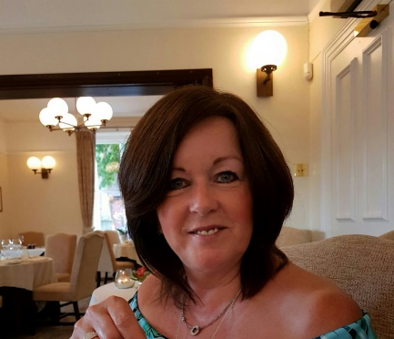
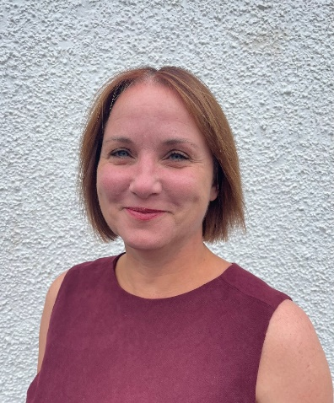
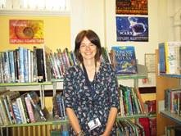
Subject teachers
Form tutor
Head of Sixth Form
Achievement Leader and Assistant Achievement Leader
Post 16 Administration Officer
Sixth Form Learning Mentor
LRC Manager
Student Support
Learning Support

Slide 4
Key dates
14th and 15th March 2023 Y12 Parents Evening
19th-23rd June 2023 Y12 exams
Sept 2023 Y13 Post 18 Information Evening
October 2023 Y13 Parents Evening
August 2024 Final exam results published

Slide 5
Social Sciences
The Social Science subjects include:
Health & Social Care,
Psychology and
Sociology
They are all popular in our Sixth Form, so many of our students study one or more Social Science subjects.

Slide 6
Sensitive Content
There are lots topics covered in Social Sciences subjects that can be difficult for some students to study, for a variety of reasons.
To help parents be aware of some of the content covered, the following slides detail some areas that might be challenging. The list is not exhaustive, but covers the key areas that have in the past been problematic for some students.

Slide 7
Health & Social Care
Addiction
Adoption
Attachment
Birth
Childhood
Death
Development (social, emotional, behavioural and cognitive)
Disease
Effects of ageing
Genetic disorders
Illness
Poverty
Pregnancy
Puberty
Medication
Mental health
Nutrition
Obesity
Self-concept and self-esteem

Slide 8
Psychology
Attachment
Anxiety
Brain and brain trauma
Crime (including murder)
Depression
Eye witness testimony
Institutionalisation in children’s homes etc.
Medication – anti-depressants, antipsychotic drugs etc.
Memory and memory loss
Neurological differences
Obsessive Compulsive Disorder
Offenders and offender profiling
Parents and absent parents
Phobias
Prison and the effects of imprisonment
Romantic relationships and their breakdown
Schizophrenia
Stress

Slide 9
Sociology
Birth and fertility rates
Crime
Crime control, surveillance and punishment
Crime statistics
Criminal justice system
Cults, sects and new age movements
Death and mortality rates
Differential educational achievement
Divorce and separation
Family
Gender roles and power relationships
Human rights
Poverty and wealth
Religion, belief and religious organisations
Secularisation
Victim of crime surveys

Slide 10
Further information
If you would like more information about course content you can look at the specification for each subject:
Health & Social Care L3 - BTEC 2016 Specification (pearson.com)
Psychology A level - https://filestore.aqa.org.uk/resources/psychology/specifications/AQA-7181-7182-SP-2015.PDF
Sociology A level - https://filestore.aqa.org.uk/resources/sociology/specifications/AQA-7191-7192-SP-2015.PDF
If you have specific questions or concerns, or if would like to make us aware of something, please contact Mrs Cottier-Cooper (Head of Social Science) via office@keslichfield.org.uk.

Slide 11
Study Skills
Mrs Crowley
Librarian and Learning Resource Centre Manager
Mrs Duval
6th Form
Academic Learning Mentor:
Sixth Form Team, Subject staff,
Student discussions

Slide 12
studying in 6th form
Regular working routine
Independent Study & Time Management
‘free’ periods = study periods

Slide 13
My role – to help students help Themselves
Consistency of the basics:
Recognising distractions
‘Cleaning’ digital & physical workspaces
Organization of files
Accessing support
Attendance & Engagement
Using time effectively
Little & often
Balancing subjects
Balancing study, hobbies, social life and work
Avoiding being ‘over-whelmed’

Slide 14
Academic Learning Skills for Sixth Form
Active study & revision skills
Strategies to challenge procrastination
Ongoing reflection and reviewing of notes – checking understanding
Additional study to lessons & ‘homework’

Slide 15
Examples of Support strategies
Effective note taking - not just highlighting!
Setting up & reviewing study timetables
Prioritising & meeting multiple deadlines
Essay writing
Variety of revision styles
Effective use of flashcards
Breaking down tasks into small chunks
Planning & time management
Exam preparation
“Desirable difficulties”

Slide 16
Variety & consistency Is the key
Key question: When & where do you work best?
Studying and revision doesn’t always have to be writing or sitting down at a desk or on your own:
verbal, listening, walking about, watching, mind maps,
spider-diagrams, flashcards ….

Slide 17
Supporting post 18
Embedding study skills for Higher Education
Transferable skills for Apprenticeships,
Work &
Wider Life

Slide 18
Library and learning resource centre

Slide 19
Open 8.30am – 4.30pm every day
Computers and iPads
Photocopying and printing

Slide 20
Dedicated study space

Slide 21
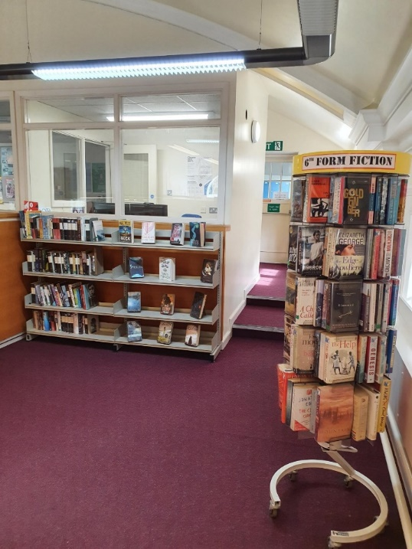
6th Form library
Textbooks
Wider reading
Fiction
Careers information

Slide 22
Periodicals

Slide 23
periodicals
Wider–reading – reading around the subject.
Authoritative and peer-reviewed.
Articles written by professionals in their field.
Accessible – not too lengthy with key information and visual aids.
Niche material that may be found in a textbook.
Current information, updated regularly and topical.
Can easily be photocopied and referred to in coursework and assessments.

Slide 24
Online information
Google Scholar
Looking for domain name clues – sch.uk, gov.uk, ac.uk
Not Wikipedia!
Which website are you using – where is the information coming from? Is it credible?
Consider the organisations you know that will have an interest in your field.

Slide 25
Who else needs to know? Who else does know?
Think about the other organisations, academic institutions, government departments, companies, charities that will know the information you are interested in.

Slide 26
suffragettes
Museum of London
British Library
Parliament.uk
Pankhurst Trust
The National Archives

Slide 27
Year 12 Information Evening Reporting on Progress
Thursday 20th October 2022
Mr Martin Shaw (Assistant Headteacher)

Slide 36
LOOKING AHEAD

Slide 37
On-going reporting of
performance in assessments

Slide 38
How We Feedback On Progress To Parents
Autumn Term Report: 12th - 16th December
Spring Term Parents’ Evening: 14th & 15th March
(on-line)
Summer Term Trial Exam Results: 10th – 14th July
On-going Progress Information: spring term
onwards
Progress updates and reports are published on
‘Go 4 Schools’ (with a notification)

Slide 39
Subject | Target Grade | Current Grade | Progress Indicator | Projected Grade | Ready: is punctual to lessons | Ready: has correct equipment | Respect: is well behaved | Respect: is engaged in lessons | Strive: works to best of ability | Strive: completes homework
Sociology | B | C | Working Towards Target | B | Always | Always | Always | Often | Always | Always
 | Comment Ella has made a really promising start to the course and appears to be well suited to the subject. Although still rather reluctant to volunteer an answer, Ella offers intelligent contributions to group discussions when nominated. Ella appears to be keeping on top of their studies and coping well with the workload. The early indication from Ella's performance in their first set of assessments is that they’ve got the potential to achieve a good grade in this subject, especially once they gain more experience answering exam style questions. Overall, a very promising start from Ella.
Below Target Working Towards Target Achieving Target Above Target

Slide 40
How are ‘target grades’ determined?

Slide 41
9
8
7
6
5
4
 | A* | A*
 | A | A
 | B | B
 | C | C
 | D | D
Y11 | Y12 | Y13
Average GCSE Score

Slide 42
Estimation Systems

Slide 43
ikl
GCSE Average Point Score
CONTEXT

Slide 44
A LEVEL HISTORY
ESTIMATE
100
90
80
70
60
50
40
30
20
10
0
FFT
50%
% CHANCE OF ACHIEVING
FFT
20%
FFT
5%
GCSE Average Point Score: 7.6
E D C B A A*
EXPECTED
GRADE RANGE

Slide 45
I’m not a number!

Slide 46
9
8
7
6
5
4
 | A* | A*
 | A | A
 | B | B
 | C | C
 | D | D
Y11 | Y12 | Y13

Slide 48
Post 18 Applications: Getting Started
September
Send out references
Bring a personal statement draft to your target setting appointment the first day back
Continue completing your form
October
Redraft your personal statement
Complete your form
November
Finalise your personal statement
Send off your form
January
For all on time applications, school with guarantee your application reaches UCAS on time
December
Final date to send applications to school is December 5th

Slide 49
Completing the form
The best resource for completing the UCAS form is using our padlet

Slide 50
Completing the form
The best resource for completing the UCAS form is using our padlet

Slide 51
Completing the form
The best resource for completing the UCAS form is using our padlet

Slide 52
Completing the form
The best resource for completing the UCAS form is using our padlet

Slide 53
Resources for parents

Slide 54
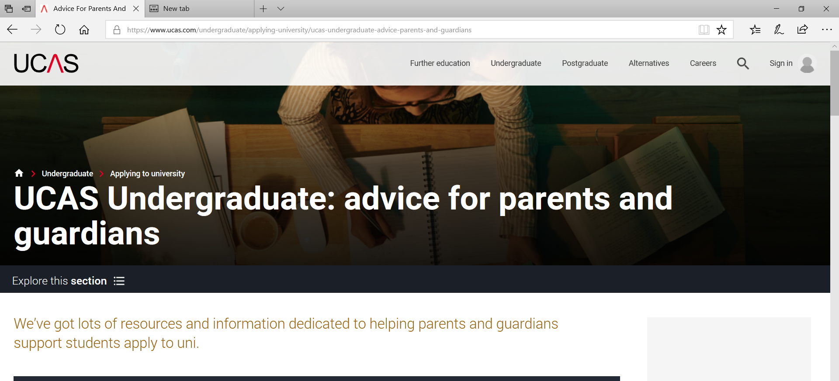
Resources for parents
The UCAS website is excellent

Slide 55
Personal Development
Students will continue to have PSHE lessons throughout sixth form. Lessons focus particularly on themes of careers, financial capability and risk management. The programme is supported by a range of external providers.
Students have a number of opportunities to develop their leadership skills and will continue to participate in as well as take a leading role in supporting and organising extra curricular activities.
Notes:
PSHE
Careers – In addition to allocated lesson time to inform and support students with their Post 18 options, students also attend careers fayre in Y12 at NEC in which Universities and Companies offering apprenticeships attend, Bridge Builders – volunteers from industry conduct mock interviews with students in Y13.
Financial Capability – students look at budgeting and the cost of living independently as well as financial risks such as Gambling and Investments. Guest speaker – ex footballer who became a gambling addict has set up a charity to raise awareness around the risks of gambling is coming into school to deliver a presentation to both Y12 and Y13 students. We also have representatives from universities who deliver sessions on the cost of going to university and the types of student finance available to support students during higher education.
Risk Management – students in Y12 will be learning to drive. We look at the costs associated with driving as well as the risks associated with driving. Students have a presentation from the Fire Brigade in Y12 around the dangers of using a mobile phone whilst driving and in Y13 around the dangers of peer pressure whilst driving.

Slide 56
Student Leadership Opportunities in Sixth Form
Ashmole Representatives
House Prefects
Prefects and Senior Prefects
Academic Mentors
Wellbeing Ambassadors
Notes:
Ashmole representatives – student council for sixth form and organise a number of fundraising events throughout the year including Food Bank appeal, McMillan Coffee Morning, Trolley Dash and last year they organised the whole school appeal to collect items to support Ukranian refugees
House Prefects – work with younger students to organise events such as house drama, cooking, sport events etc
Prefects and Senior Prefects – represent the school at events, tour guides
Academic Mentors – provide support to younger students in English and Maths
Wellbeing Ambassadors – peer support to younger students in registrations and at social times.

Slide 57
Wellbeing at KEVI
At King Edward VI School we actively promote resilience and positive wellbeing for all our students and staff. Wellbeing is a key feature of our overall school vision. We strive to ensure that we create an environment of high expectations and support, promoting wellbeing of all as a key priority.
Notes:
Examples
We have an Open Door policy for any student to talk about any issues academic or pastoral with teaching and support staff
Laptop loans for use in the sixth form so no one is disadvantaged
Free period products available in the sixth form toilets
Kettle available to make hot drinks/pot noodles etc.
New comfortable, modern seating in the Common Room for social times
A pleasant working environment with tables and chairs in the Common Room for study periods
Space base facility for quiet time out and wellbeing hub

Slide 58
What support is available for students in Sixth Form?
Form Tutor
Student Support (PSA)
School Counsellor
Careers Advisor
Learning Mentor
Sixth Form Leadership Team
Sixth Form Administrator
Notes:
Sixth Form Leadership team – DJB, JRW, SJH
Sixth Form Administrator – provides support with UCAS applications, careers appointment bookings, general enquiries.
Careers Advisor – fortnightly appointments offered with Bob Keen, an independent Careers Advisor.
Learning Mentor – Lynne supporting students with organisation and independent study skills

