Slide 1
Psychology & Reading

Slide 2
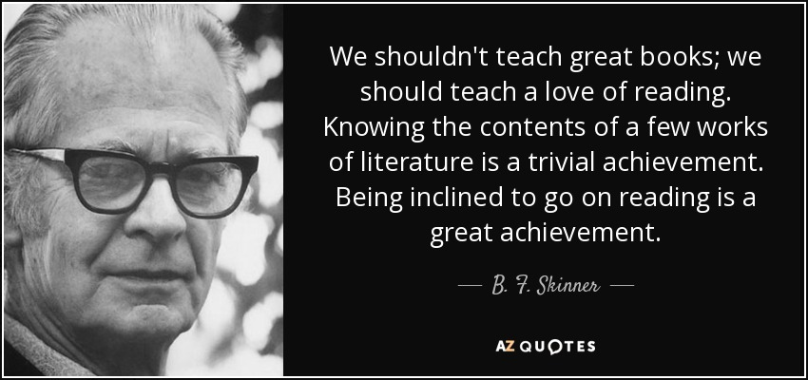

Slide 3
Reading For Psychology
Reading is hugely important when studying Psychology, as it not only develops your understanding of the human mind and behaviour; it also develops your understanding of key concepts and your written skills. Any reading is therefore beneficial, but some books are of particular use. Read what you can and think about what they suggest about the human mind and behaviour.

Slide 4
AQA A Level Psychology Specification states:
Assessment in A-level Psychology includes questions that allow students to demonstrate their ability to:
draw together their skills, knowledge and understanding from across the full course of study
provide extended responses
The exams contain extended response questions. An ‘extended response’ is evidence of sufficient length generated to allow students to demonstrate their ability to construct and develop a sustained line of reasoning which is coherent, relevant, substantiated and logically structured.
https://filestore.aqa.org.uk/resources/psychology/specifications/AQA-7181-7182-SP-2015.PDF

Slide 5
Psychology Review
You can subscribe and receive your own copies of Psychology review each year, or you can read them in the LRC. Each copy has interesting articles to develop your knowledge and skills in Psychology.

Slide 6
Psychology: Reading List

Slide 7
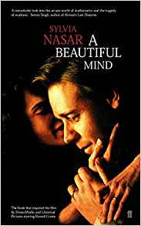
A Beautiful Mind
Author: | Sylvia Nasar
What’s it about? | True story of mathematician John Nash and his struggle with schizophrenia
What topics is it useful for? | Psychopathology, Schizophrenia
Difficulty level: | ***
Rating: | *****

Slide 8
A Sense of Freedom
Author: | Jimmy Boyle
What’s it about? | Is Jimmy’s experience of youth in Gorbals, imprisonment as a young man and the courage to start life over again as a renowned sculpture artist.
What topics is it useful for? | All of psychology.
Difficulty level: | **
Rating: | ****

Slide 9
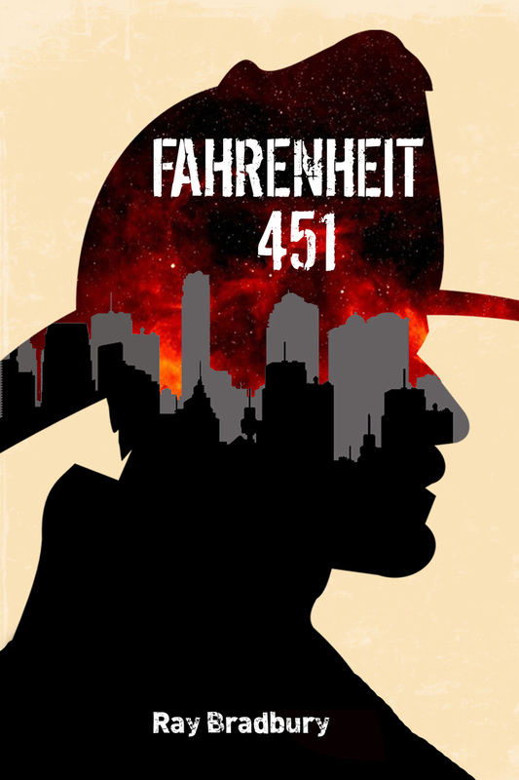
Farenheit 451
Author: | Ray Bradbury
What’s it about? | The novel presents a future American society where books are outlawed and "firemen" burn any that are found. It is a futuristic science fiction novel showing the dangers of censorship.
What topics is it useful for? | All of psychology.
Difficulty level: | **
Rating: | ****

Slide 10
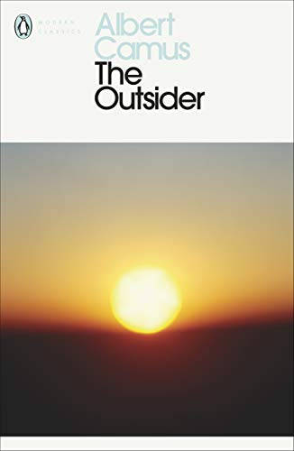
The outsider
Author: | Albert Camus
What’s it about? | A coming of age novel, narrated by its 14-year-old protagonist, dealing with socioeconomic disparities and impositions, violence, friendship, and the need of a sense of belonging.
What topics is it useful for? | All of psychology.
Difficulty level: | **
Rating: | ****

Slide 11
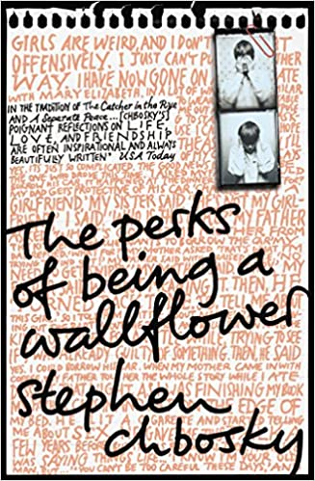
The Perks of Being a Wallflower
Author: | Albert Camus
What’s it about? | Coming of age story that people are more than a disorder or a trauma.
What topics is it useful for? | All of psychology.
Difficulty level: | **
Rating: | ****

Slide 12
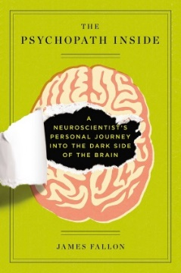
The Psychopath Inside
Author: | James Fallon
What’s it about? | An autobiographical account of James Fallon, a neuroscientist who found out he had the brain wiring of a psychopath.
What topics is it useful for? | Neuroscience, forensics, biopsychology
Difficulty level: | **
Rating: | ****

Slide 13
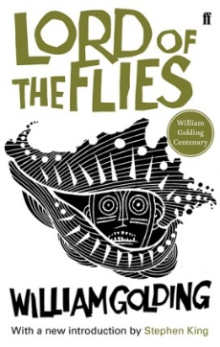
Lord of the Flies
Author | William Golding
What’s it about? | The plot concerns a group of British boys who are stranded on an uninhabited island and their disastrous attempts to govern themselves.
What topics is it useful for? | Social influence.
Difficulty level: | **
Rating: | ****

Slide 14
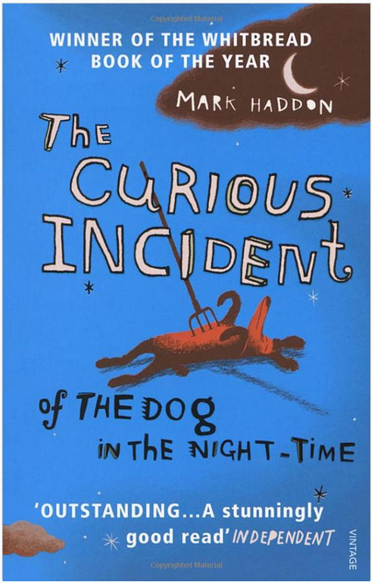
The Curious Incident of the Dog in the Night-Time
Author | Mark Haddon
What’s it about? | The story takes place through the eyes of a young boy. This novel is a murder mystery and a story of a boy at age fifteen.
What topics is it useful for? | Psychopathology, attachment, forensics.
Difficulty level: | **
Rating: | ****

Slide 15
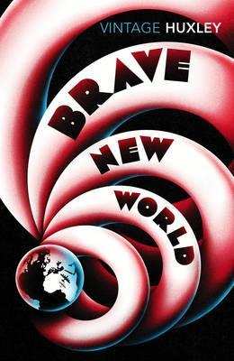
A Brave New World
Author | Aldous Huxley
What’s it about? | The book presents a nightmarish vision of a future society. Plot summary Brave New World is set in 2540.
What topics is it useful for? | All of psychology.
Difficulty level: | **
Rating: | ****

Slide 16
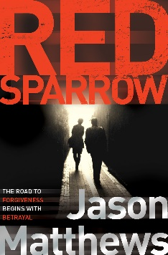
Red Sparrow
Author | Jason Matthews
What’s it about? | A spy thriller about Russian double agent Dominika Egorova and CIA agent Nate Nash. The author and former CIA officer Jason Matthews talks about M.I.C.E. - the four motivations that drive targets to reveal their secrets.
What topics is it useful for? | Forensics, social influence and psychopathology.
Difficulty level: | **
Rating: | ****

Slide 17
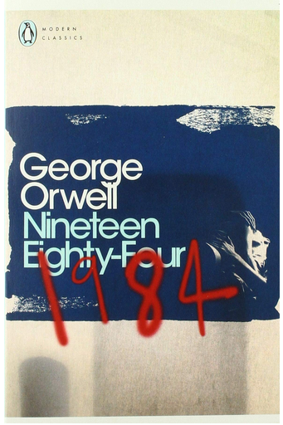
Nineteen Eighty-Four
Author | George Orwell
What’s it about? | Dystopian social science fiction novel - a warning against totalitarianism
What topics is it useful for? | Social influence
Difficulty level: | **
Rating: | ****

Slide 18
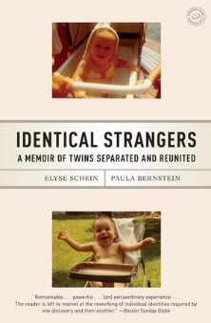
Identical Strangers
Author | E. Schein & P. Bernstein
What’s it about? | A memoir written by identical twins Elyse Schein and Paula Bernstein. The authors were separated as infants, in part, to participate in a "nature versus nurture" twin study.
What topics is it useful for? | Social influence, attachment, relationships, approaches, issues/debates
Difficulty level: | **
Rating: | ****

Slide 19
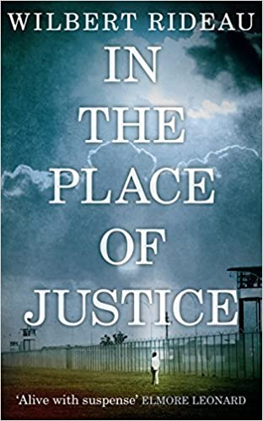
In the Place of Justice
Author | Wilbert Rideau
What’s it about? | A story of punishment and deliverance,” told by a high school dropout who escaped Angola’s electric chair to become an award-winning prison journalist.
What topics is it useful for? | Social influence, forensics
Difficulty level: | **
Rating: | ****

Slide 20
Picking Cotton
Author | Thompson-Cannino, R. Cotton & E. Torneo
What’s it about? | A memoir written by Ronald Cotton and Jennifer Thompson-Cannino. The co-authors share a unique relationship. When she was 22, Jennifer mistakenly identified Ronald as the man who raped her in her apartment.
What topics is it useful for? | Social influence, forensics
Difficulty level: | **
Rating: | ****

Slide 21
The Colour Purple
Author | Alice Walker
What’s it about? | The Colour Purple movingly depicts the growing up and self-realization of Celie, who overcomes oppression and abuse to find fulfilment and independence. The novel also addresses gender equality.
What topics is it useful for? | Social influence, attachment, psychopathology, relationships, issues and debates.
Difficulty level: | **
Rating: | ****
Trailer

Slide 22
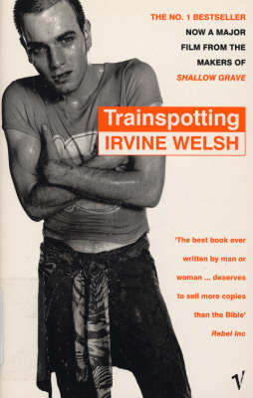
Trainspotting
Author | Irvine Welsh
What’s it about? | Collection of short stories revolving around various residents of Edinburgh who either use heroin, are friends of the core group of heroin users, or engage in destructive addictions. The novel is set in the late 1980s.
What topics is it useful for? | Social influence, psychopathology, forensics, issues and debates.
Difficulty level: | **
Rating: | ****

Slide 23
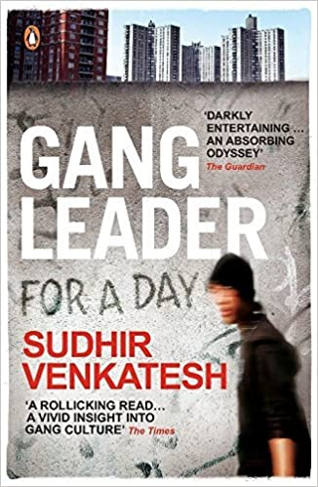
Gang Leader for a Day
Author | Sudhir Venkatesh
What’s it about? | An autobiographical account of a sociologist's six years of living with and studying of the residents of a housing project called Robert Taylor in Chicago.
What topics is it useful for? | Social influence, forensics, issues and debates.
Difficulty level: | **
Rating: | ****

Slide 24
Bad Pharma
Author: | Ben Goldacre
What’s it about? | How pharmaceutical companies employ sneaky techniques to make their drugs look better than they are
What topics is it useful for? | Research Methods, Psychopathology, Schizophrenia
Difficulty level: | *****
Rating: | *****

Slide 25
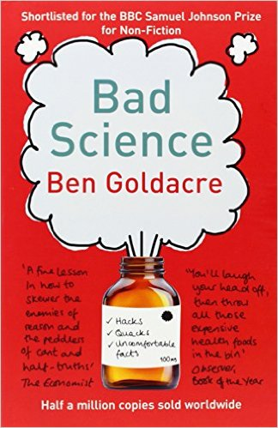
Bad Science
Author: | Ben Goldacre
What’s it about? | How to do research properly
What topics is it useful for? | Research Methods, Psychopathology, Schizophrenia
Difficulty level: | *****
Rating: | *****

Slide 26
Behind the Shock Machine
Author: | Gina Perry
What’s it about? | The real story behind the Milgram obedience research
What topics is it useful for? | Social Influence, Research Methods, Issues and debates
Difficulty level: | **
Rating: | *****

Slide 27
Blink
Author: | Malcolm Gladwell
What’s it about? | The psychology of success
What topics is it useful for? | Research Methods
Difficulty level: | ***
Rating: | ***

Slide 28
Bounce
Author: | Matthew Syed
What’s it about? | The psychology of success in sport
What topics is it useful for? | Research Methods
Difficulty level: | ***
Rating: | ***

Slide 29
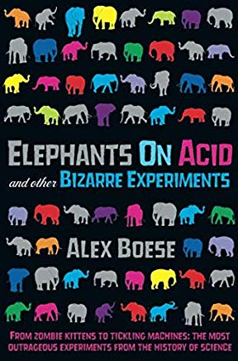
Elephants on acid and other bizarre experiments
Author: | Alex Boese
What’s it about? | Excellent accounts of some of the most important and interesting experiments in biology and psychology
What topics is it useful for? | Research Methods Approaches An excellent all-rounder
Difficulty level: | **
Rating: | ****

Slide 30
Forever Today
Author: | Deborah Wearing
What’s it about? | True story of a famous amnesiac patient, Clive Wearing.
What topics is it useful for? | Memory, Biopsychology
Difficulty level: | **
Rating: | ****

Slide 31
Great Myths of the Brain
Author: | Christian Jarrett
What’s it about? | The myths surrounding the world’s most complex computer
What topics is it useful for? | Biopsychology, Psychopathology, Research Methods
Difficulty level: | ***
Rating: | ***

Slide 32
I think you’ll find it’s a bit more complicated than that…
Author: | Ben Goldacre
What’s it about? | A collection of articles about how research should be done correctly
What topics is it useful for? | Research Methods, Psychopathology, Schizophrenia
Difficulty level: | ****
Rating: | ****

Slide 33
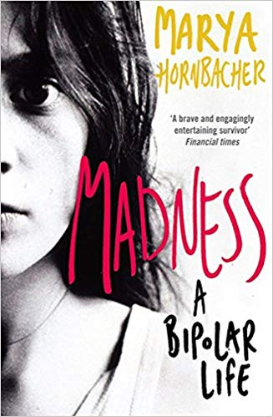
Madness: A bipolar’ s life
Author: | Marya Hornbacher
What’s it about? | A memoir about the most severe form of bipolar disorder called: Rapid Cycling Type 1. She describes her struggles with the demons she faces every day, wavering between madness and deep bouts of depression.
What topics is it useful for? | Research Methods, Social Influence
Difficulty level: | ***
Rating: | **

Slide 34
Man (Dis)connected
Author: | Philip Zimbardo
What’s it about? | Why men are failing in modern society
What topics is it useful for? | Research Methods, Social Influence
Difficulty level: | ***
Rating: | **

Slide 35
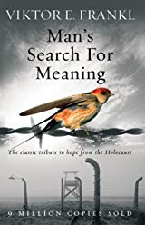
Man’s search for meaning
Author: | Viktor E Frankl
What’s it about? | A 1946 book by Viktor Frankl, chronicling his experiences as a prisoner in Nazi concentration camps during World War II, and describing his psychotherapeutic method, which involved identifying a purpose in life to feel positively about, and then immersively imagining that outcome.
What topics is it useful for? | Psychopathology, aggression, social influence
Difficulty level: | ***
Rating: | **

Slide 36
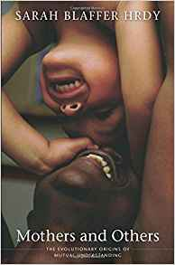
Mothers and others: The Evolutionary Origins of Mutual Understanding
Author: | Sarah Blaffer-Hrdy
What’s it about? | Finds the key in the primatologically unique length of human childhood
What topics is it useful for? | Research Methods, Attachments, Evolution.
Difficulty level: | ****
Rating: | *****

Slide 37
Night School
Author: | Richard Wiseman
What’s it about? | Sleep
What topics is it useful for? | Biopsychology
Difficulty level: | ***
Rating: | *****

Slide 38
Obedience to Authority
Author: | Stanley Milgram
What’s it about? | Milgram’s famous shock experiments
What topics is it useful for? | Social Influence, Aggression, Research Methods, Issues and debates
Difficulty level: | *****
Rating: | **

Slide 39
Opening Skinner’s Box
Author: | Lauren Slater
What’s it about? | A collection of short summaries of famous psychology studies
What topics is it useful for? | Social Influence, Memory, Attachment, Psychopathology, Biopsychology, Research Methods
Difficulty level: | ***
Rating: | *****

Slide 40
Paranormality
Author: | Richard Wiseman
What’s it about? | The psychology behind ghosts, ghouls and the paranormal
What topics is it useful for? | Research Methods
Difficulty level: | **
Rating: | ***

Slide 41
Patient H.M.
Author: | Luke Dittrich
What’s it about? | The most famous case study in psychology, H.M.
What topics is it useful for? | Memory, Biopsychology, Issues and debates
Difficulty level: | ***
Rating: | *****

Slide 42
Pioneers of Psychology
Author: | Raymond Fancher
What’s it about? | The history of psychology
What topics is it useful for? | Approaches, Biopsychology, Issues and Debates
Difficulty level: | *****
Rating: | ****

Slide 43
Quirkology
Author: | Richard Wiseman
What’s it about? | A collection of weird and wonderful psychology studies
What topics is it useful for? | Memory, Social Influence, Attachment, Psychopathology, Aggression, Relationships, Research Methods
Difficulty level: | **
Rating: | ****

Slide 44
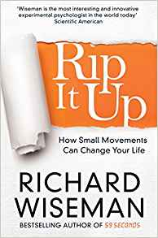
Rip it up.
Author: | Richard Wiseman
What’s it about? | Demonstrates how simple actions are the most powerful way to instantly change how you think and feel. Forget positive thinking, it's time for positive action.
What topics is it useful for? | Memory, Social Influence, Attachment, Psychopathology, Aggression, Relationships, Research Methods. Good all-rounder.
Difficulty level: | **
Rating: | ****

Slide 45
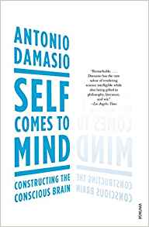
Self comes to mind: constructing the conscious brain
Author: | Antonio Damasio
What’s it about? | The eminent neurologist and neuroscientist Antonio Damasio gives an account of consciousness.
What topics is it useful for? | Psychopathology, Approaches, Biopsychology, Research Methods.
Difficulty level: | ****
Rating: | ****

Slide 46
Shrinks
Author: | Jeffrey A. Lieberman
What’s it about? | The history of mental health treatment
What topics is it useful for? | Psychopathology, Schizophrenia, Approaches, Biopsychology
Difficulty level: | ****
Rating: | ****

Slide 47
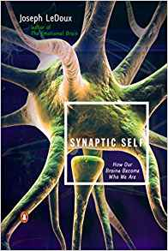
Synaptic Self: How Our Brains Become Who We Are.’
Author: | Joseph LeDoux
What’s it about? | Examination of the biological bases of our emotions and memories.
What topics is it useful for? | Psychopathology, Schizophrenia, Approaches, Biopsychology
Difficulty level: | *****
Rating: | *****

Slide 48
Tell Me I’m Here
Author: | Anne Deveson
What’s it about? | True story of a mother whose son has schizophrenia
What topics is it useful for? | Schizophrenia, Psychopathology
Difficulty level: | **
Rating: | ****

Slide 49
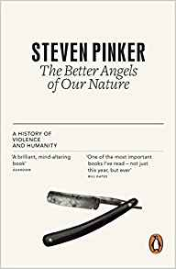
The Better Angels of our nature: Why violence has declined.
Author: | Mary Turner Thompson
What’s it about? | Pinker convincingly demonstrates that there has been a dramatic decline in violence, and he is persuasive about the causes of that decline.
What topics is it useful for? | Psychopathology, Aggression, Approaches, Methods
Difficulty level: | *****
Rating: | ****

Slide 50
The Bigamist
Author: | Mary Turner Thompson
What’s it about? | A true story of a woman’s life with a psychopath
What topics is it useful for? | Psychopathology
Difficulty level: | *
Rating: | ****

Slide 51
The Brain that Changes Itself
Author: | Norman Doidge
What’s it about? | How our brains are plastic and can physically change throughout or lives
What topics is it useful for? | Biopsychology, Research Methods, Memory, Psychopathology
Difficulty level: | ****
Rating: | *****

Slide 52
The Brain: The Story of You
Author: | David Eagleman
What’s it about? | How the brain influences our behaviour
What topics is it useful for? | Biopsychology, Attachment, Memory, Schizophrenia, Psychopathology, Aggression
Difficulty level: | ****
Rating: | *****

Slide 53
The Center Cannot Hold
Author: | Elyn R. Saks
What’s it about? | An autobiography of someone who has survived schizophrenia
What topics is it useful for? | Schizophrenia, Psychopathology, Research Methods
Difficulty level: | **
Rating: | ***

Slide 54
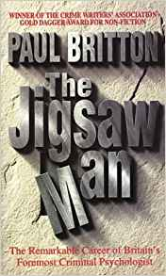
The Jigsaw Man
Author: | Paul Britton
What’s it about? | Forensic psychologist Paul Britton takes you through the field of crime deduction. He has the ability to 'walk through the minds' of those who stalk, abduct, torture, rape and kill other human beings.
What topics is it useful for? | Research Methods, Aggression
Difficulty level: | **
Rating: | *****

Slide 55
The Lucifer Effect
Author: | Philip Zimbardo
What’s it about? | The Stanford Prison study
What topics is it useful for? | Social Influence, Research Methods, Aggression
Difficulty level: | ****
Rating: | ***

Slide 56
The Man Who Couldn’t Stop
Author: | David Adam
What’s it about? | The history of OCD told from the perspective of someone with the disorder
What topics is it useful for? | Psychopathology, Approaches
Difficulty level: | ***
Rating: | *****

Slide 57
The Man Who Mistook His Wife for a Hat
Author: | Oliver Sacks
What’s it about? | Interesting case studies of brain-damaged patients
What topics is it useful for? | Approaches, Issues and debates, Biopsychology
Difficulty level: | *****
Rating: | ***

Slide 58
The Man Who Shocked the World
Author: | Thomas Blass
What’s it about? | A biography of Stanley Milgram
What topics is it useful for? | Social Influence, Aggression, Approaches
Difficulty level: | ***
Rating: | ****

Slide 59
The Memory Illusion
Author: | Julia Shaw
What’s it about? | Problems with memory, particularly eyewitness testimony
What topics is it useful for? | Memory, Research Methods
Difficulty level: | ***
Rating: | *****

Slide 60
The Psychopath Test
Author: | Jon Ronson
What’s it about? | A journalist’s investigation into what makes someone a psychopath
What topics is it useful for? | Psychopathology, Research Methods, Issues and debates
Difficulty level: | ***
Rating: | *****

Slide 61
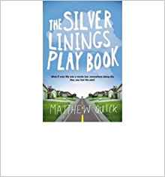
The Silver Linings Playbook
Author: | Matthew Quick
What’s it about? | Pat returns to love with his parents following time in a mental institution.
What topics is it useful for? | Psychopathology.
Difficulty level: | **
Rating: | ****

Slide 62
The Skeleton Cupboard
Author: | Tanya Byron
What’s it about? | A collection of stories from the early career of a clinical psychologist
What topics is it useful for? | Psychopathology, Schizophrenia
Difficulty level: | **
Rating: | ****

Slide 63
The Tell-Tale Brain
Author: | V.S. Ramachandran
What’s it about? | The way the brain perceives the world
What topics is it useful for? | Biopsychology, Research Methods
Difficulty level: | *****
Rating: | ***

Slide 64
The Trouble with Testosterone
Author: | Robert Sapolski
What’s it about? | The effect of testosterone on human behaviour, namely aggression
What topics is it useful for? | Aggression, Biopsychology, Approaches
Difficulty level: | ****
Rating: | ***

Slide 65
Testing Treatments
Author: | Imogen Evans
What’s it about? | How to do research properly
What topics is it useful for? | Research Methods, Psychopathology, Schizophrenia
Difficulty level: | *****
Rating: | ****

Slide 66
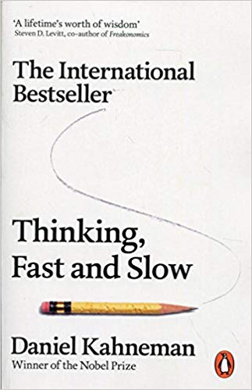
Thinking fast and slow
Author: | Daniel Kahneman
What’s it about? | A masterpiece exploring human rationality and irrationality.
What topics is it useful for? | Cognitive psychology.
Difficulty level: | *****
Rating: | *****

Slide 67
Trick or Treatment?
Author: | Simon Singh and Edzard Ernst
What’s it about? | Bogus science and how to detect it
What topics is it useful for? | Research Methods, Psychopathology, Schizophrenia
Difficulty level: | ****
Rating: | ****

Slide 68
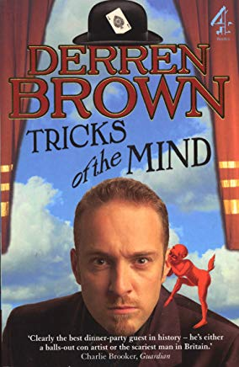
Tricks of the Mind
Author: | Derren Brown
What’s it about? | An insight into a range of psychology experiments.
What topics is it useful for? | Memory, Research Methods. Good all-rounder.
Difficulty level: | ***
Rating: | *****

Slide 69
Quiet
Author: | Susan Cain
What’s it about? | Explore the introvert/extrovert divide in personality.
What topics is it useful for? | Cognitive psychology, approaches, personality.
Difficulty level: | ****
Rating: | *****

Slide 70
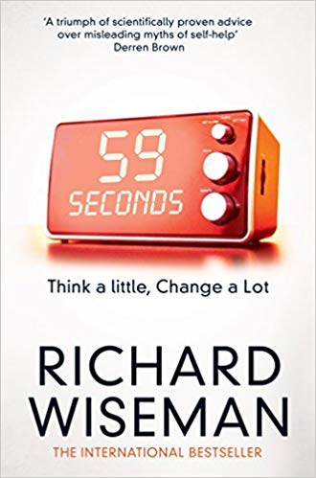
59: seconds
Author: | Richard Wiseman
What’s it about? | A collection of weird and wonderful psychology studies
What topics is it useful for? | All of psychology.
Difficulty level: | **
Rating: | ****

Slide 71
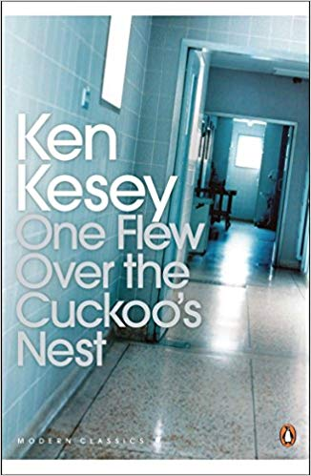
One flew over the cuckoo’s nest
Author: | Ken Kesey
What’s it about? | Set in an Oregon psychiatric hospital, the narrative serves as a study of institutional processes and the human mind as well as a critique of behaviorism and a tribute to individualistic principles.
What topics is it useful for? | Psychopathology,
Difficulty level: | ***
Rating: | *****

Slide 72
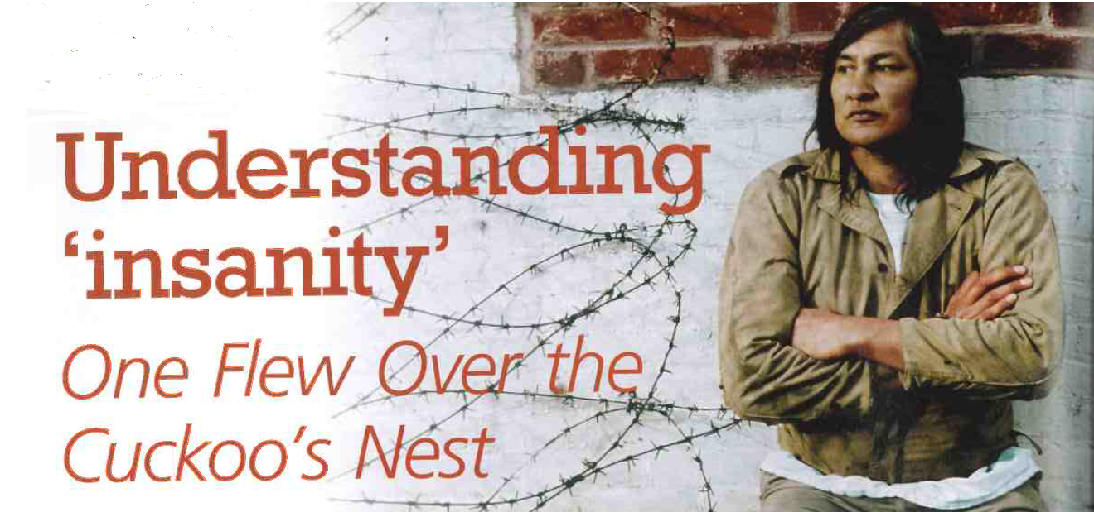

Slide 73
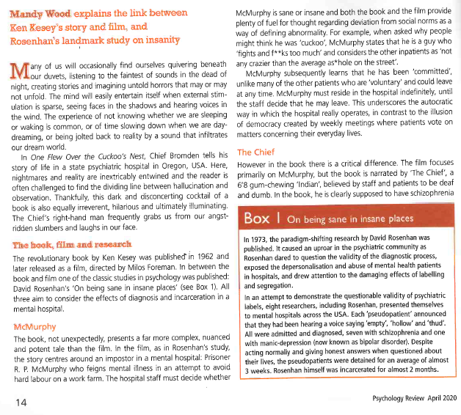
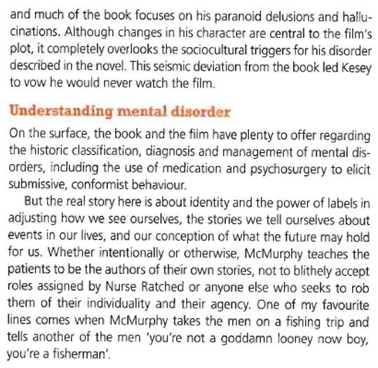

Slide 74
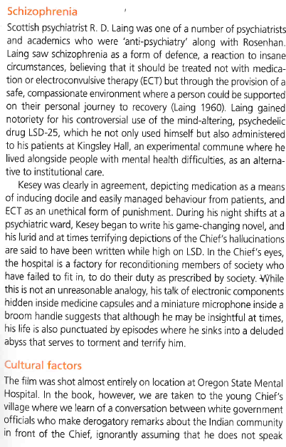
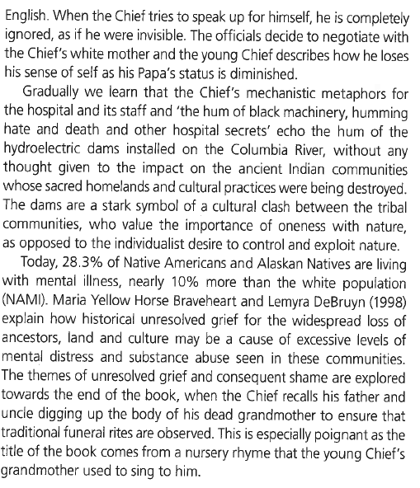
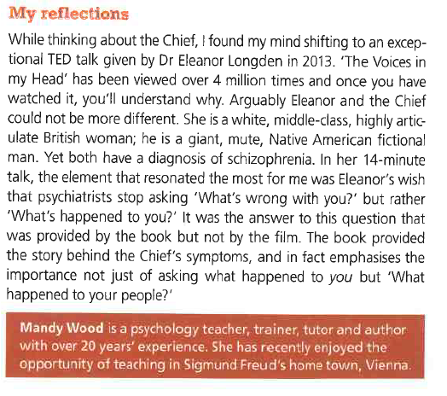
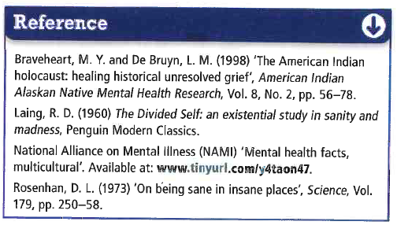

Slide 75
Psychology: Watch List

Slide 76
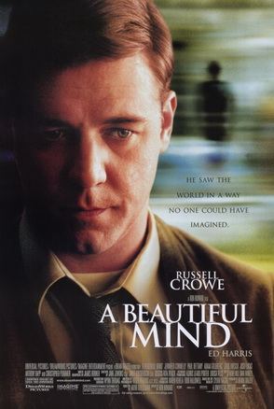
A Beautiful Mind
Starring: | Russell Crowe
What’s it about? | True story of mathematician John Nash and his struggle with schizophrenia.
What topics is it useful for? | Psychopathology, Schizophrenia
Age rating: | 12
Realism rating: | *****
Rating: | *****

Slide 77
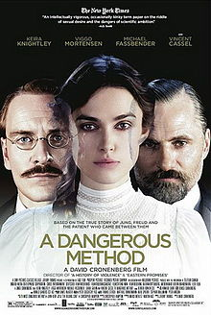
A Dangerous Method
Starring: | Keira Knightley
What’s it about? | Freud and Jung take their ideas to America but disagree massively in how they view one famous patient.
What topics is it useful for? | Approaches, Psychopathology
Age rating: | 15
Realism rating: | ****
Rating: | ****

Slide 78
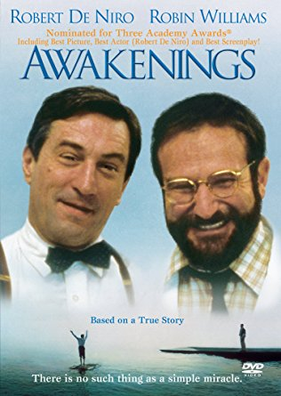
Awakenings
Starring: | Robert de Niro, Robin Williams
What’s it about? | A psychiatrist goes to work with a group of mental health patients whose illness cannot be diagnosed.
What topics is it useful for? | Psychopathology
Age rating: | 12
Realism rating: | *****
Rating: | ***

Slide 79
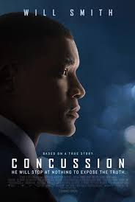
Concussion
Starring: | Will Smith
What’s it about? | Neuropsychologists discovers deterioration similar to Alzheimer's when conducting an autopsy. The doctor embarks on a mission to raise awareness about football-related head injuries.
What topics is it useful for? | Biopsychology
Age rating: | PG
Realism rating: | *****
Rating: | ****
Trailer

Slide 80
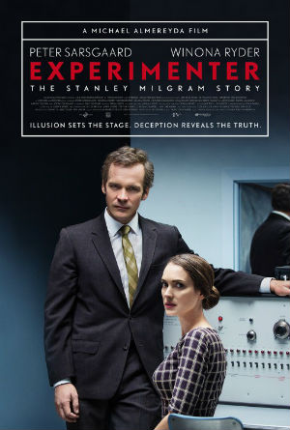
Experimenter
Starring: | Peter Sarsgaard, Winona Ryder
What’s it about? | The life and times of Stanley Milgram and his famous obedience research
What topics is it useful for? | Social Influences, Approaches, Issues and debates, Research Methods
Age rating: | 15
Realism rating: | ****
Rating: | *****

Slide 81
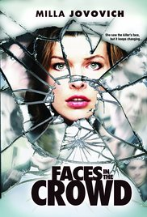
Faces in the Crowd
Starring: | Milla Jovovich
What’s it about? | A woman is attacked and loses her ability to recognise faces, which is a problem as she is the only one who can recognise the attacker
What topics is it useful for? | Biopsychology
Age rating: | 15
Realism rating: | **
Rating: | **

Slide 82
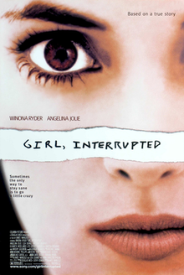
Girl, Interrupted
Starring: | Angelina Jolie
What’s it about? | Follows a characters stay in a mental institution following a nervous breakdown. Links to stigma of psychological illness.
What topics is it useful for? | Psychopathology
Age rating: | 15
Realism rating: | ****
Rating: | ****

Slide 83
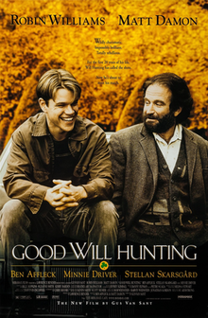
Good will hunting.
Starring: | Robin Williams, Matt Damon
What’s it about? | Follows a young man with exceptional mathematical abilities. Abused as a child, he has a range of issues and finally receives counselling to enable him to change his life.
What topics is it useful for? | Attachments.
Age rating: | 15
Realism rating: | *****
Rating: | *****

Slide 84
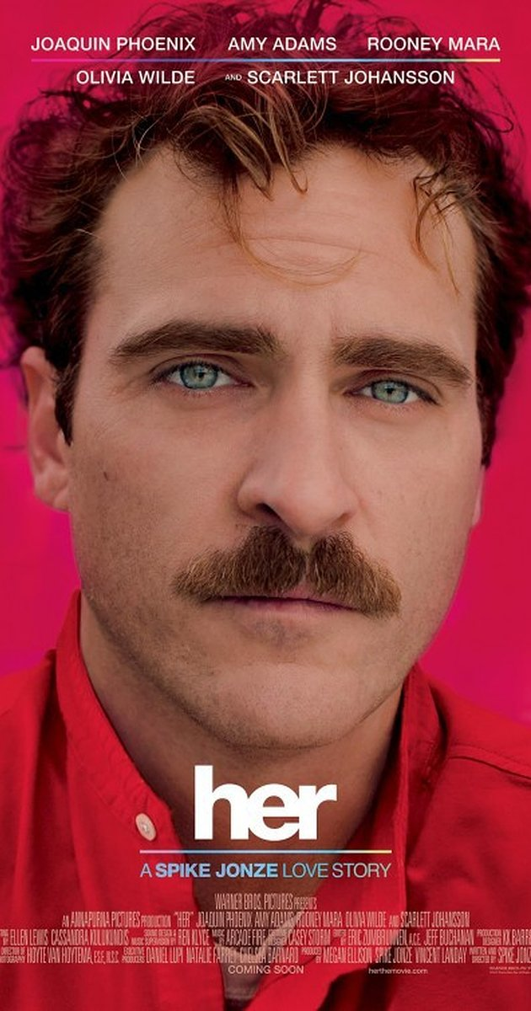
Her
Starring: | Joaquin Phoenix
What’s it about? | A man with a broken heart starts an online relationship
What topics is it useful for? | Relationships (virtual relationships)
Age rating: | 15
Realism rating: | **
Rating: | *****

Slide 85
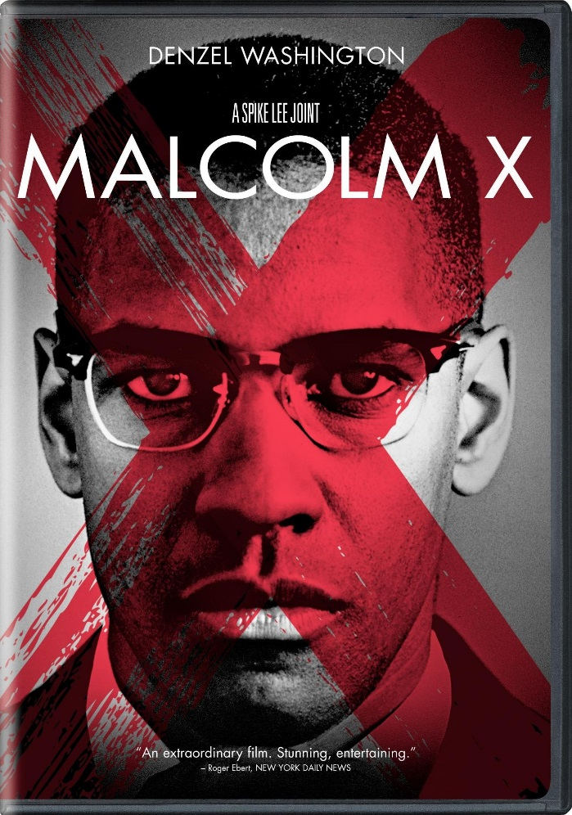
Malcolm X
Starring: | Denzel Washington
What’s it about? | The true story of civil rights campaigner, Malcolm X
What topics is it useful for? | Social influence (social change)
Age rating: | 15
Realism rating: | ****
Rating: | ****

Slide 86
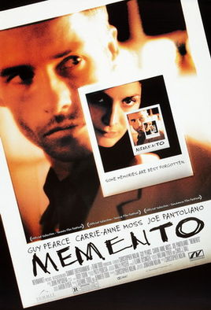
Memento
Starring: | Guy Pearce
What’s it about? | A man loses the ability to form new memories but needs to find a way to remember who killed his wife so he can exact revenge
What topics is it useful for? | Memory
Age rating: | 15
Realism rating: | ***
Rating: | ****
Trailer

Slide 87
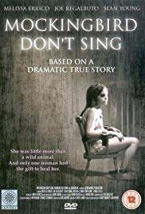
Mocking bird don’t sing
Starring: | Sean Young
What’s it about? | 13 year old suffering the most extreme abuse ever discovered.
What topics is it useful for? | Attachments.
Age rating: | 12
Realism rating: | *****
Rating: | ***

Slide 88
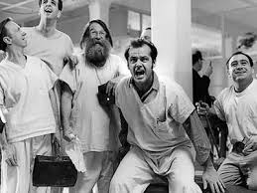
One flew over the Cuckoo’s nest
Starring: | Jack Nicholson
What’s it about? | A criminal is placed in a mental institution rather than a jail. Shows the disturbing reality of early mental health care.
What topics is it useful for? | Psychopathology Issues and debates
Age rating: | PG
Realism rating: | *****
Rating: | *****

Slide 89
Project Nim
Starring: | Nim Chimpsky
What’s it about? | A chimp is raised as a human and taught sign language
What topics is it useful for? | Issues and debates
Age rating: | 12
Realism rating: | *****
Rating: | *****

Slide 90
Rain Man
Starring: | Dustin Hoffman, Tom Cruise
What’s it about? | Man discovers his estranged father has died and left his million-dollar estate to his other son, who is autistic.
What topics is it useful for? | Biopsychology, hemispheric lateralisation Issues and debates
Age rating: | PG
Realism rating: | *****
Rating: | *****
Trailer

Slide 91
Selma
Starring: | David Oyelowo
What’s it about? | The true story of Martin Luther King’s march from Selma
What topics is it useful for? | Social Influence (social change)
Age rating: | 15
Realism rating: | *****
Rating: | ***

Slide 92
Shutter Island
Starring: | Leonardo di Caprio
What’s it about? | A woman has disappeared from a mental health institution and detectives are sent to investigate
What topics is it useful for? | Psychopathology
Age rating: | 15
Realism rating: | ***
Rating: | *****

Slide 93
Split
Starring: | James McAvoy
What’s it about? | Girls are kidnapped by a man with multiple personality disorder
What topics is it useful for? | Psychopathology
Age rating: | 15
Realism rating: | **
Rating: | *****

Slide 94
The Break-up
Starring: | Jennifer Ainston
What’s it about? | Explores the formation and breakdown of a romantic relationship.
What topics is it useful for? | Relationships
Age rating: | 12
Realism rating: | *****
Rating: | ****

Slide 95
The Bodyguard
Starring: | Whitney Houston
What’s it about? | Famous popstar Whitney Houston becomes the victim of threatening behaviour from a fan.
What topics is it useful for? | Relationships Aggression
Age rating: | 12
Realism rating: | ***
Rating: | ****

Slide 96
The Experiment
Starring: | Adrien Brody, Forest Whitaker
What’s it about? | A Hollywood interpretation of the famous Stanford Prison study
What topics is it useful for? | Social Influence, Aggression
Age rating: | 15
Realism rating: | *
Rating: | ***

Slide 97
The Men Who Stare at Goats
Starring: | Ewan McGregor, George Clooney
What’s it about? | A journalist researches a military department designed to use mind control in their army
What topics is it useful for? | Psychopathology
Age rating: | 15
Realism rating: | *****
Rating: | ****

Slide 98
The Notebook
Starring: | Ryan Gosling, Rachel McAdams
What’s it about? | The story of unwavering love.
What topics is it useful for? | Relationships
Age rating: | 12
Realism rating: | *****
Rating: | ****

Slide 99
The Soloist
Starring: | Robert Downey Jr., Jamie Foxx
What’s it about? | True story of a talented musician who struggles with schizophrenia
What topics is it useful for? | Psychopathology, Schizophrenia
Age rating: | 15
Realism rating: | ****
Rating: | ****

Slide 100
The Stanford Prison Experiment
Starring: | Billy Crudup
What’s it about? | The original SPE
What topics is it useful for? | Social Influence, Aggression, Research Methods
Age rating: | 15
Realism rating: | ****
Rating: | ****
Trailer

Slide 101
The Shawshank Redemption
Starring: | Tim Robbins, Morgan Freeman
What’s it about? | Explores the hardships of life in the prison of Shawshank
What topics is it useful for? | Social Influence, Aggression (institutionalisation in prisons)
Age rating: | 15
Realism rating: | *****
Rating: | *****
Trailer

Slide 102
The Wave (Die Walle)
Starring: | Jurgen Vogel
What’s it about? | Based on a true story. A teacher sets up a demonstration with his class to show them how Hitler rose to power
What topics is it useful for? | Social Influence
Age rating: | 15
Realism rating: | ***
Rating: | ****

Slide 103
We need to talk about Kevin
Starring: | Tilda Swinton
What’s it about? | After-math of a Columbine-style shooting at a school in a small American town.
What topics is it useful for? | Social Influence, media influences on behaviour, aggression, approaches
Age rating: | 15
Realism rating: | ***
Rating: | ****

Slide 104
12 Angry Men
Starring: Henry Fonda
What’s it about? | A jury deliberate on the fate of someone accused of murder. One lone dissenter puts a compelling case to convince the other 11 jurors that this is not a clear-cut case.
What topics is it useful for? | Social Influence
Age rating: | PG
Realism rating: | ***
Rating: | ***
Trailer

Slide 105
The King’s Speech
Starring: | Colin Firth
What’s it about? | The tale of Elizabeth II's father and his remarkable friendship with speech therapist Lionel Logue. It charts the personal relationship that developed between England's reluctant King George VI, plagued by a nervous stammer.
What topics is it useful for? | Social Influence, psychopathology, approaches
Age rating: | 12
Realism rating: | ***
Rating: | ****
Trailer

Slide 106
The Breakfast Club
Starring: | Emilio Estevez
What’s it about? | 1985 American teen coming-of-age comedy-drama film.
What topics is it useful for? | Social Influence, media influences on behaviour, aggression, approaches
Age rating: | 12
Realism rating: | ***
Rating: | ****
Trailer

Slide 107
Hotel Rwanda
Starring: | Don Cheadle
What’s it about? | Hotel Rwanda which depicts his heroic acts in saving over 1,000 people inside a hotel he managed during the 1994 Genocide against the Tutsi.
What topics is it useful for? | Social Influence, aggression, approaches, issues and debates
Age rating: | 12
Realism rating: | ***
Rating: | ****
Trailer

Slide 108
Psychology: Documentaries and talks
Watch as many of the following documentaries and talks as you have time to. What have you learned about human behaviour, the mind and the differences and similarities between people?

Slide 109
Documentaries and talks
Attachment and the Growth of Love - Ainsworth
Controversy of Intelligence: Crash Course Psychology #23
Exploring the mind of a killer | Jim Fallon
Girl living with worst ever case of Tourette’s
How reliable is your memory? | Elizabeth Loftus
I Am Not A Monster: Schizophrenia | Cecilia McGough
I Think We’re Alone Now
Inside Broadmoor
Personality Disorders: Crash Course Psychology #34
Prejudice and Discrimination: Crash Course Psychology #39
The Man Who Loved The Number 12
The Man With The Seven Second Memory
The Mary Bell Case | Documentary Heaven
The Milgram Experiment 1962 Full Documentary
The psychology of evil | Philip Zimbardo
The Stanford Prison Experiment
Total Recall - People who remember every second of their life | 60 Minutes Australia
Tourettes: I Swear I Can’t Help It
Wild Child The Story Of Feral Children

Slide 110
Psychology: Journal articles

Slide 111
Journal Articles
Social Influence
Asch, S. E. (1956). Studies of independence and conformity: A minority of one against a unanimous majority. Psychological Monographs, 70(9, Whole No. 416).
http://www.cynlibsoc.com/clsology/pdf/people-will-conform.pdf
Bond, R. & Smith, P. B. (1996) Culture and Conformity: A Meta-Analysis of Studies Using Asch's(1952b, 1956) Line Judgment Task. Psychological Bulletin1996, Vol. 119, No.1,111-137
http://citeseerx.ist.psu.edu/viewdoc/download?doi=10.1.1.454.2768&rep=rep1&type=pdf
Haney, C., Banks, W. C., & Zimbardo, P. G. (1973) Interpersonal dynamics in a simulated prison. International Journal of Criminology and Penology, 1973,1, 69-97.
http://pdf.prisonexp.org/ijcp1973.pdf
Milgram, S. (1963). Behavioral study of obedience. Journal of Abnormal and Social Psychology, 67, 371–378.
https://pdfs.semanticscholar.org/29e4/8c1365346fc67137423a016096622ac6a215.pdf?_ga=2.68230033.1833816449.1591207362-130841783.1591207362
Moscovici, S. Lage, E. and Naffrechoux, M. (1969) Influence of a Consistent Minority on the Responses of a Majority in a Color Perception Task.
https://www.researchgate.net/publication/17796328_Influence_of_a_Consistent_Minority_on_the_Responses_of_a_Majority_in_a_Color_Perception_Task

Slide 112
Memory
Miller, G. (1956) ‘The Magical Number Seven, Plus Or Minus Two: Some limits on our capacity for processing information.’ - https://pdfs.semanticscholar.org/4023/ae0ba18eed43a97e8b8c9c8fcc9a671b7aa3.pdf?_ga=2.30137151.1833816449.1591207362-130841783.1591207362
Atkinson, R. C., & Shiffrin, R. M. (1968). Chapter: Human memory: A proposed system and its control processes. In Spence, K. W., & Spence, J. T. The psychology of learning and motivation (Volume 2). New York: Academic Press. pp. 89–195. - https://app.nova.edu/toolbox/instructionalproducts/edd8124/articles/1968-Atkinson_and_Shiffrin.pdf
Peterson, L. R., Peterson, M. J. (1959). Short-term retention of individual verbal items. Journal of Experimental Psychology, 58, 193–198. - http://citeseerx.ist.psu.edu/viewdoc/download?doi=10.1.1.227.1807&rep=rep1&type=pdf
Baddeley, A. D., & Hitch, G. (1974). Working memory. In G.H. Bower (Ed.), The psychology of learning and motivation: Advances in research and theory (Vol. 8, pp. 47–89). New York: Academic Press. - https://app.nova.edu/toolbox/instructionalproducts/edd8124/fall11/1974-Baddeley-and-Hitch.pdf
Godden, D. R. & Baddeley, A.D. (1975) Context-dependent memory in two natural environments: on land and underwater. Br. J. Psychol., 66, 3, pp. 325-331 - https://msu.edu/course/psy/401/Readings/Godden%20&%20Baddeley%20%281975%29.pdf
Loftus, E. F., & Palmer, J. C. (1974). Reconstruction of auto-mobile destruction: An example of the interaction between language and memory. Journal of Verbal Learning and Verbal behavior, 13, 585-589. - https://www.demenzemedicinagenerale.net/images/mens-sana/AutomobileDestruction.pdf
Geiselman, Fisher, MacKinnon and Holland (1985) Eyewitness Memory Enhancement in the Police Interview: Cognitive Retrieval Mnemonics Versus Hypnosis. Journal of Applied Psychology, Vol. 70, No. 2, 401-412 - http://citeseerx.ist.psu.edu/viewdoc/download?doi=10.1.1.615.6444&rep=rep1&type=pdf
Geiselman, Fisher, MacKinnon, & Holland (1986) Enhancement of Eyewitness Memory with the Cognitive Interview. The American Journal of Psychology, Vol. 99, No. 3. (Autumn, 1986), pp. 385-401. - https://www.researchgate.net/publication/232592783_Enhancement_of_Eyewitness_Memory_with_the_Cognitive_Interview/link/54c02ef30cf28eae4a68b4df/download
Fisher, Geiselman & Armador (1989) Field Test of the Cognitive Interview: Enhancing the Recollection of Actual Victims and Witnesses of Crime - http://www.loreto.herts.sch.uk/wp-content/uploads/FisherStudy.pdf

Slide 113
Attachment
Ainsworth, M. D. S., & Bell, S. M. (1970). Attachment, exploration, and separation: Illustrated by the behavior of one-year-olds in a strange situation. Child Development, 41, 49-67. - https://pdfs.semanticscholar.org/8272/bd76f36d195023f245735e23e6b5c8b19afd.pdf?_ga=2.26425021.1833816449.1591207362-130841783.1591207362
Van Ijzendoorn, M. H., & Kroonenberg, P. M. (1988). Cross-cultural patterns of attachment: A meta-analysis of the strange situation. Child Development, 147-156. - https://openaccess.leidenuniv.nl/bitstream/handle/1887/11634/7_702_111.pdf
Psychopathology
Rosenhan, D. L. (1973) ‘Being Sane in Insane Places’ - https://www.canonsociaalwerk.eu/1971_stigma/1973%20Rosenhan%20Being%20sane%20in%20insane%20places%20OCR.pdf
Ellis, A. (1957). Rational Psychotherapy and Individual Psychology. Journal of Individual Psychology, 13: 38-44. - https://pdfs.semanticscholar.org/552c/e878498ce8e8c2b57ff62144538f1ac3d84c.pdf

Slide 114
Approaches
Watson, J. B., Rayner, R. (1920). Conditioned emotional reactions. Journal of Experimental Psychology, 3, 1–14. - https://www.kinged.org.uk/attachments/download.asp?file=1410&type=pdf
Skinner, B. F. (1938). The behavior of organisms: An experimental analysis. New York: Appleton-Century. - http://s-f-walker.org.uk/pubsebooks/pdfs/The%20Behavior%20of%20Organisms%20-%20BF%20Skinner.pdf
Bandura, A. (1977). Social learning theory. Englewood Cliffs, NJ: Prentice Hall. - http://garfield.library.upenn.edu/classics1991/A1991GD62000001.pdf
Bandura, A., Ross, D., & Ross, S. A. (1961). Transmission of aggression through imitation of aggressive models. The Journal of Abnormal and Social Psychology, 63(3), 575–582 - https://pdfs.semanticscholar.org/3706/7acd33ad2ba2ed384baada06e7d74b800399.pdf
Maslow, A. H. (1954). Motivation and personality. New York: Harper and Row. - http://s-f-walker.org.uk/pubsebooks/pdfs/Motivation_and_Personality-Maslow.pdf
Biopsychology
Maguire, E. A. et al. (2000) Navigation-related structural change in the hippocampi of taxi drivers - https://www.ncbi.nlm.nih.gov/pmc/articles/PMC18253/pdf/pq004398.pdf

Slide 115
Relationships
Buss, David M. 1989. “Sex Differences in Human Mate Preferences: Evolutionary Hypotheses Tested in 37 Cultures.” Behavioral and Brain Sciences - https://philipperushton.net/wp-content/uploads/2015/02/iq-race-sex-gender-survey-mate-buss-nyborg-rushton-buss-behavioral-brain-sciences-19891.pdf
Walster, E., Aronson, V., Abrahams, D., & Rottman, L. (1966). Importance of physical attractiveness in dating behavior. Journal of Personality and Social Psychology, 4(5), 508–516. - https://pdfs.semanticscholar.org/24cd/a8a1d4da014e9ab91a4e73f2f988209c1bd4.pdf
Clark, R. D., & Hatfield, E. (1989). Gender differences in receptivity to sexual offers. Journal of Psychology & Human Sexuality, 2(1), 39–55. - https://www.sciencefriday.com/wp-content/uploads/2016/04/gender-differences-in-receptivity-to-sexual-offers.pdf

Slide 116
Schizophrenia
Ripke, S., B. M. Neale, A. Corvin, J. T. Walters, K. Farh, P. A. Holmans, P. Lee, et al. (2014) “Biological Insights From 108 Schizophrenia-Associated Genetic Loci.” - https://dash.harvard.edu/bitstream/handle/1/13890642/4112379.pdf?sequence=1
Fromm-Reichmann, F. (1948) Notes on the Development of Treatment of Schizophrenics by Psychoanalytic Psychotherapy - http://www.psychodyssey.net/wp-content/uploads/2012/05/Fromm-Reichmann-Psychiatry1948.pdf
Forensic Psychology
Farrington, D. P. et al. (2006) Criminal careers up to age 50 and life success up to age 48: new findings from the Cambridge Study in Delinquent Development - http://mws-73973.mws3.csx.cam.ac.uk/people/academic_research/david_farrington/hors299.pdf
Canter, David V. (2010) Offender profiling. In: The Cambridge Handbook of Forensic Psychology. Cambridge Handbooks in Psychology . Cambridge University Press, Cambridge, UK, pp. 236­241. - http://eprints.hud.ac.uk/id/eprint/8796/6/CanterOffenderAuthorVersionpdf.pdf
Eysenck, S. & Eysenck, H. (1977) Personality Differences Between Prisoners and Controls - https://hanseysenck.com/wp-content/uploads/2019/12/1977_eysenck_eysenck_-_personality_differences_between_prisoners_and_controls_psychological_reports.pdf

Slide 117
Other journal articles
Gardner, R. A., Gardner, B. T. (1969). Teaching sign language to a chimpanzee. Science, 165, 664–672. - https://pdfs.semanticscholar.org/a4d2/8094c9e41b753cfdcf51bc9a9b5ba2a0c219.pdf
Darley, J. M., Latané, B. (1968). Bystander intervention in emergencies: Diffusion of responsibility. Journal of Personality and Social Psychology, 8, 377–383. - https://pdfs.semanticscholar.org/432a/51ae6e67a9c7fdb7b97c4917da96bb3140cf.pdf
Bem, S. L. (1974). The measurement of psychological androgyny. Journal of Consulting and Clinical Psychology, 42, 155–162. - http://garfield.library.upenn.edu/classics1981/A1981MH61900001.pdf

