Slide 1
Post 18 Applications
Getting Started

Slide 2
Post 18 Applications: Getting Started
Deadlines
All student reference requests must go out before the end of the Autumn term
University – your form must be submitted to school by Dec 4th
Medicine and Oxbridge by Oct 2nd
College Apprenticeships
Employment Gap Year
Notes:
Non uni applications have individual dates

Slide 3
Post 18 Applications: Getting Started
September
Send out references to relevant staff
Bring a personal statement draft to your target setting appointment the first day back
Continue completing your form
October
Redraft your personal statement
Complete your form
November
Finalise your personal statement
Send off your form
January
For all on time applications, school with guarantee your application reaches UCAS on time
December
Final date to send applications to school is December 4th

Slide 4
Questions everyone always asks!
You can choose up to 5 courses.
These are arranged in alphabetical order, NOT your order of preference
You can only write ONE personal statement so it needs to be appropriate for all of your courses
You can apply for more than one course at the same university, e.g. the foundation course AND the main course

Slide 5
Questions everyone always asks!
When you ‘pay and send’ your applications arrives at school for us to check it and to add your reference. You pay and send as soon as you can!
The fee for your application DOES NOT come to school, it is an administration fee from UCAS
We cannot guarantee when you will receive offers but many students do receive them in the Autumn term each year

Slide 6
The Personal Statement
Students had a session in July 2023 on writing their personal statement
Students should have brought a draft to their tutor meeting at the start of term to receive feedback on
4000 characters including spaces
Why you have chosen the subject (75%)
Personal information (25%)
Your tutor will read drafts for you and help you with your personal statement
You can also ask subject teachers for their advice

Slide 7
The Personal Statement
What can you do to help students?
TED talks
Periodicals from the LRC
Unifrog
University websites
Reputable news websites

Slide 8
The School Reference
Changes in 2024 cycle

Slide 9
The School Reference
Changes in 2024 cycle

Slide 10
The School Reference
Changes in 2024 cycle

Slide 11
The School Reference
written by the tutor
includes comments from relevant subject staff and predicted grades- changes this year
will highlight positive traits and achievements and aim to validate and support the personal statement (communication with the tutor is key)
Predicted grades
Please discuss with teaching staff at Parents’ Evening
Realistic but aspirational

Slide 12
Receiving Offers
offers are either CONDITIONAL or UNCONDITIONAL.
if in initial applications you do not gain places, you can enter EXTRA
if you do not get the grades in August/ you do better than you expect, you can enter CLEARING
There are a small number of unconditional offers each year, it is more likely a university may lower grades e.g. if a student puts it as their firm choice. This may also help them receive funding/ first choice accommodation

Slide 13
Completing the form
Students attended a session on registering and starting to complete their forms in July
The best resource for completing the UCAS form is using our padlet

Slide 14
Completing the form
The best resource for completing the UCAS form is using our padlet

Slide 15
Completing the form
The best resource for completing the UCAS form is using our padlet

Slide 16
Completing the form
The best resource for completing the UCAS form is using our padlet

Slide 17
Resources for parents

Slide 18
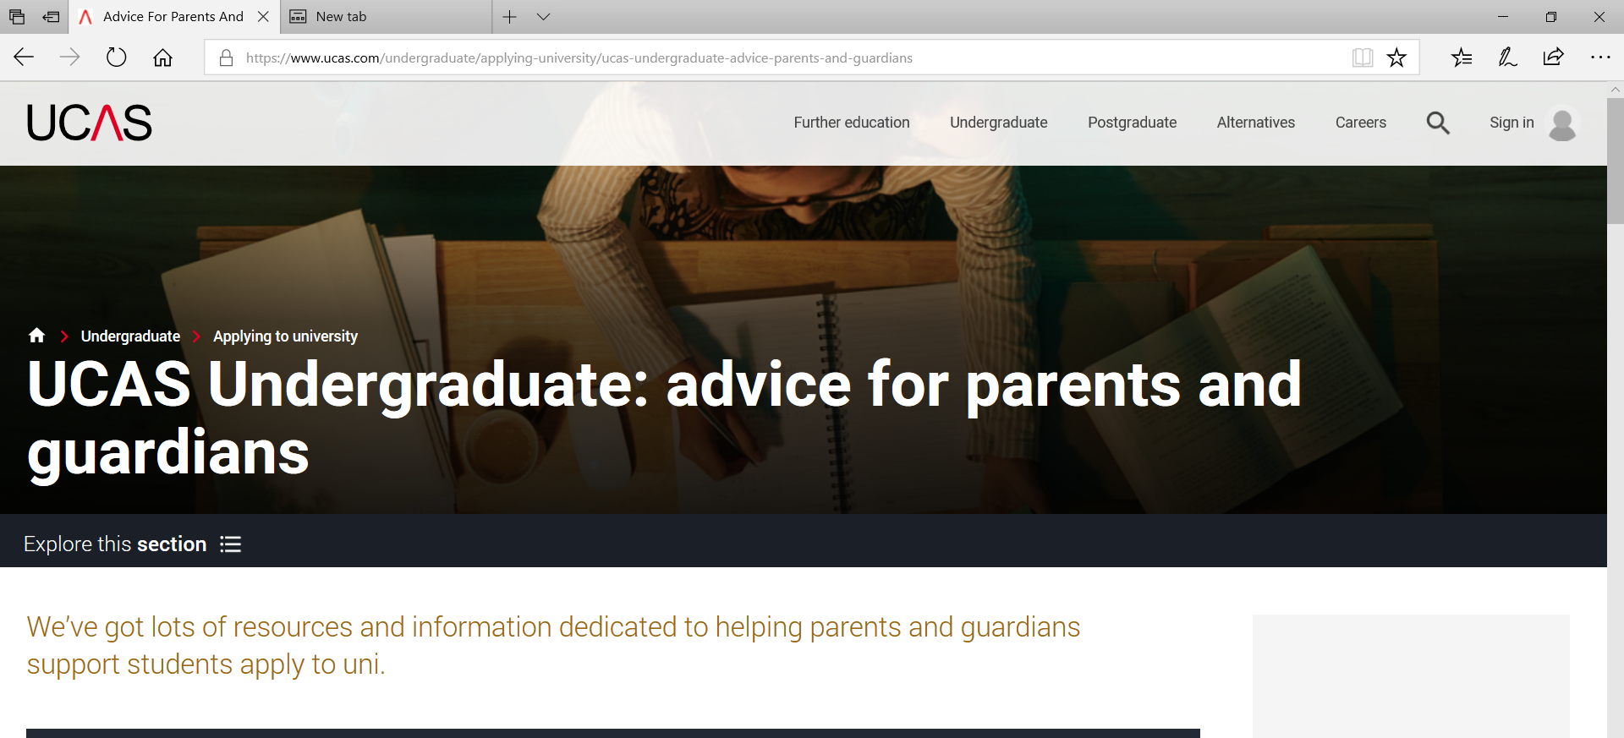
Resources for parents
The UCAS website is excellent

Slide 19
Any questions?

