Slide 1
Post 18 Applications
Getting Started

Slide 2
Post 18 Applications: Getting Started
Whatever plans a student has, they need a reference from school

Slide 3
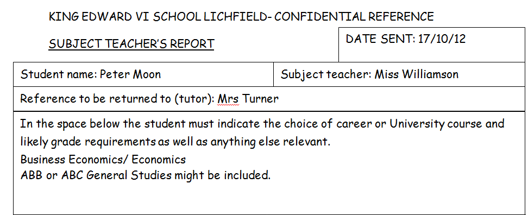

Slide 5
Post 18 Applications: Getting Started
Deadlines
All student reference requests must go out before the end of the Autumn term
University – form must be submitted to school by Dec 16th
Medicine and Oxbridge by Oct 3rd
College Apprenticeships
Employment Gap Year

Slide 6
Applying to UCAS
www.ucas.com
online application – as of 1st September
the three most important elements are:
1. Your personal statement.
2. Your exam results and/or predictions.
3. The school reference (written by tutor).
Deadline for application is 15th January 2017 (Oxbridge and medical courses are 15th October 2016).
application charge payable by debit/credit card
The earlier the better – offers can be made before Jan.

Slide 7
Applying to UCAS
www.ucas.com
register before summer holidays and receive school ‘buzzword’ so you can apply in September.
the application includes five sections:
i) choices
ii) about you
iii) education
iv) statement
v) employment

Slide 8
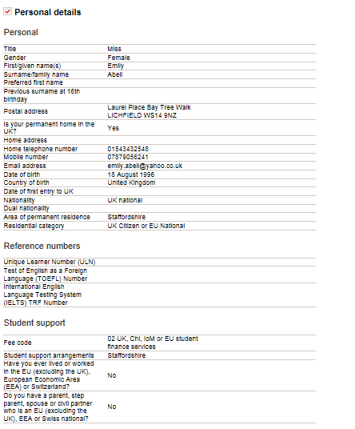
Applying to UCAS
www.ucas.com

Slide 9
Applying to UCAS
www.ucas.com

Slide 10
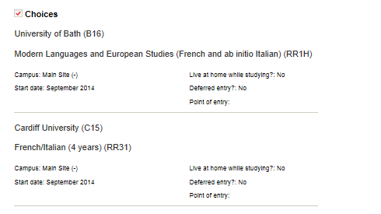
Applying to UCAS
www.ucas.com

Slide 11
Applying to UCAS
www.ucas.com
Students have 5 choices
We recommend
1/2 aspirational choice
2/3 sensible choices – usually the same grades as AS or one grade higher in one or two subjects
1 lower choice that can act as insurance choice
Students need to apply for courses where they can meet the grade requirements- they need to be realistic
If students make applications to courses that they do not meet the requirements for by a number of grades, they are likely to be rejected

Slide 12
Applying to UCAS
www.ucas.com
Choices will be in points or grades

Slide 13
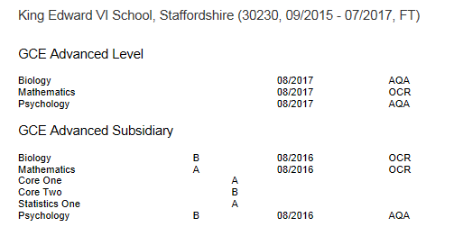
Applying to UCAS
www.ucas.com

Slide 14
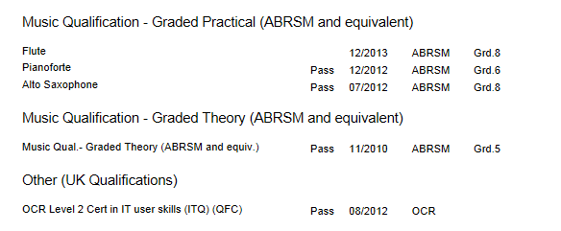
Applying to UCAS
www.ucas.com

Slide 15
Completing the form
www.ucas.com
Students need to enter details such as GCSE results as well as other qualifications such as Duke of Edinburgh, music grade exams
Students can ask their tutors for help with this
Students can also use the drop in sessions with Mrs Patey-Round on a Friday lunch in Y4
Students who are unsure about their courses/choices can discuss this with their tutor and also can book an appointment with our careers advisor Bob

Slide 16
The Personal Statement
written by the candidate – about one side A4 (4000 characters)
replaces interviews for most institutions
should include two elements:
Why you have chosen the subject (75%)
2. Personal information (25%)
Your tutor will read drafts for you and help you with your personal statement
You can also ask subject teachers for their advice

Slide 17
The School Reference
based on tutor’s opinions and brief references from subject teachers.
will highlight positive traits and achievements and aim to validate and support the personal statement (communication with the tutor is key)
predicted grades are made by teaching staff based on results so far and their professional judgement
students send out reference requests to all staff following the return to Y13 in September (communicating the requirements of the course here is key)

Slide 18
Exam Results
AS overall grades must be entered, module/ paper grades are an optional extra
it is unlikely that universities will make judgments on particular modules – although it is possible
UCAS operate a points system which you should familiarise yourself with:
A=48 (AS=20), B=40 (AS=16)

Slide 19
Receiving Offers
offers can be in grades or points
offers are either CONDITIONAL or UNCONDITIONAL.
if initial applications fail you can enter EXTRA
if you fail to get the grades in August you can enter CLEARING
if you do better than expected you can take part in the ADJUSTMENT process

Slide 20
Thank you for listening

