Slide 1
Blencathra Field Studies
Course 2019

Slide 2
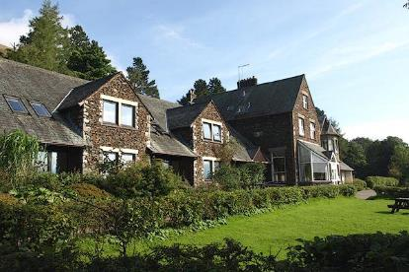
Where are we staying?
Field studies council centre - Blencathra, Lake District

Slide 3
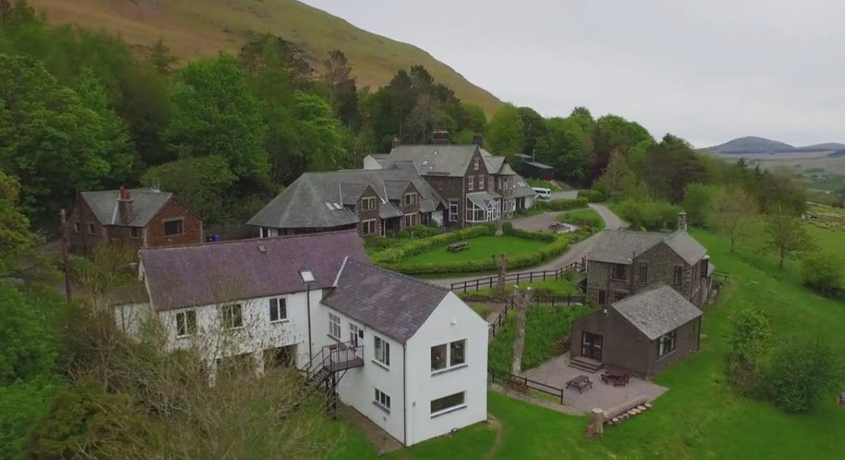
Blencathra Centre

Slide 4
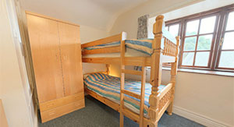
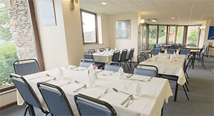
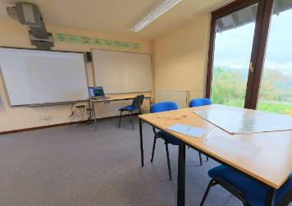
Blencathra Centre

Slide 5
Facilities
Games room – pool table, table tennis
TV room
Drying room
Library
Walking boot hire
Computer suite
Fieldwork labs
Classrooms with digital projectors
Two hectares of wooded grounds
Facilities for hot and cold drinks (bring snacks)

Slide 6
Fieldwork Requirements
All students are required to undertake fieldwork in relation to processes in both physical and human geography. Students must undertake four days of fieldwork during their A-level course.
Schools and colleges are required to provide a fieldwork statement that confirms each student has undertaken four days of geographical fieldwork in relation to processes in both physical and human geography. Schools and colleges must provide the fieldwork statement by 15 May in the year of entry. Any failure to provide this statement in a timely manner will be treated as malpractice or maladministration (under Ofqual's General Condition A8 (Malpractice and maladministration)).

Slide 7
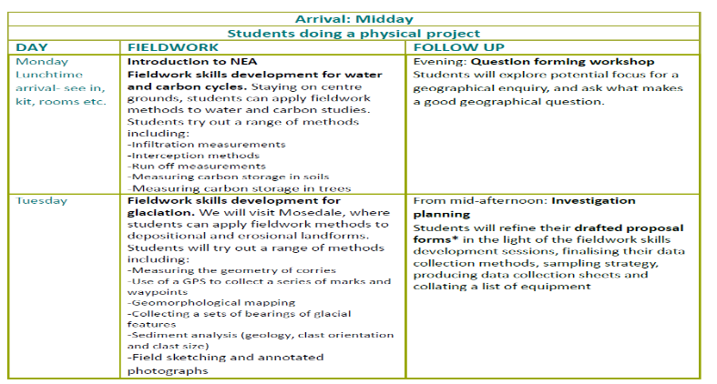
Itinerary

Slide 8
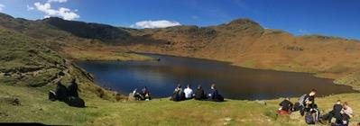
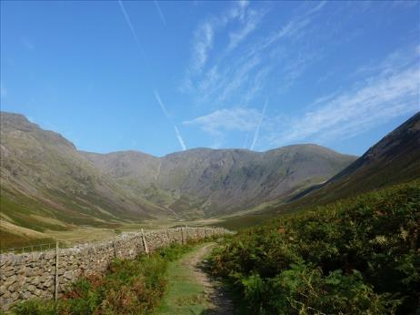
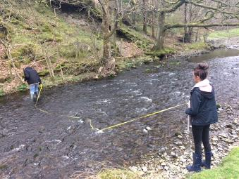
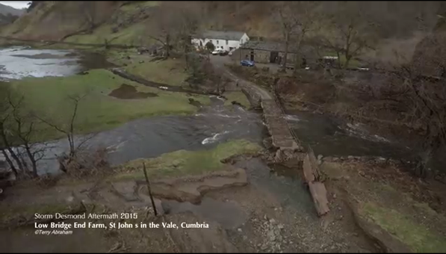
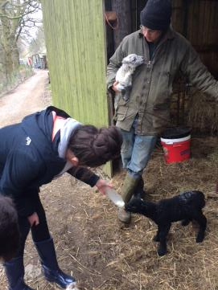

Slide 9
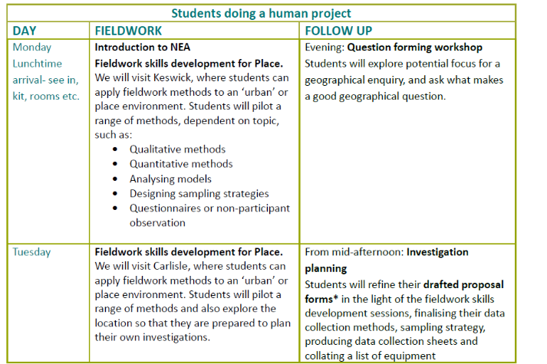
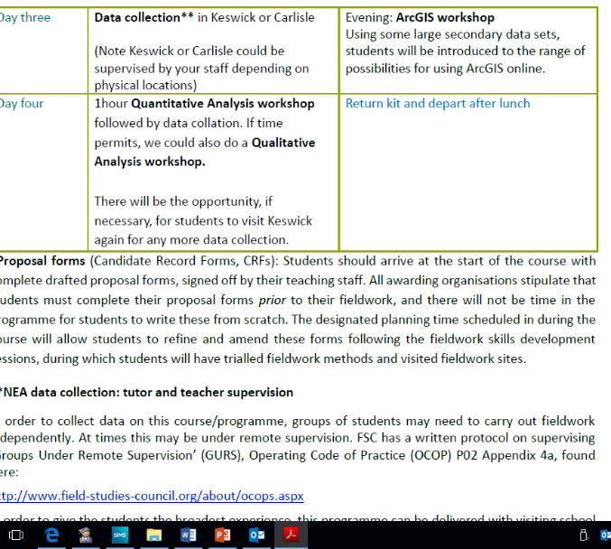

Slide 10
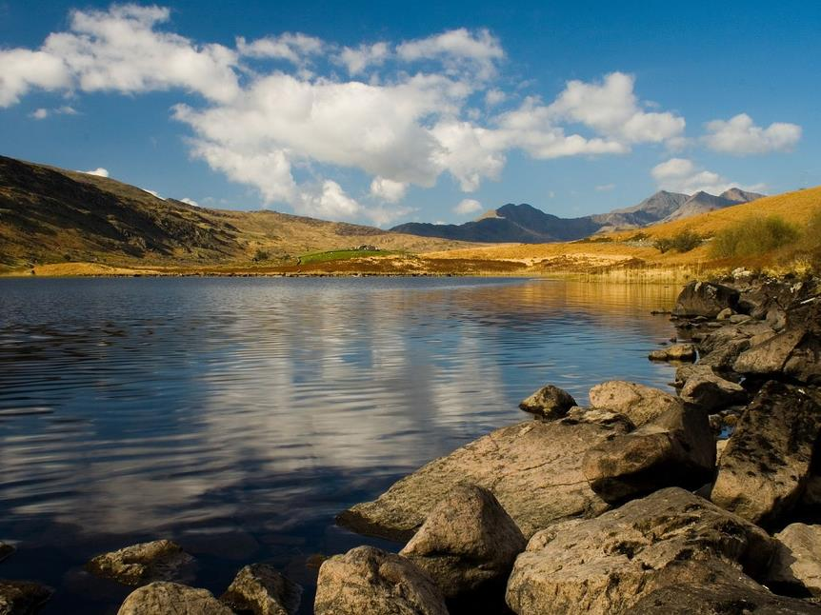
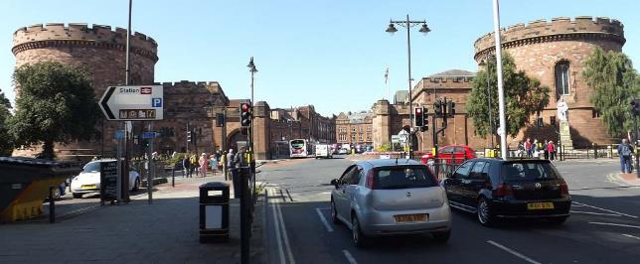
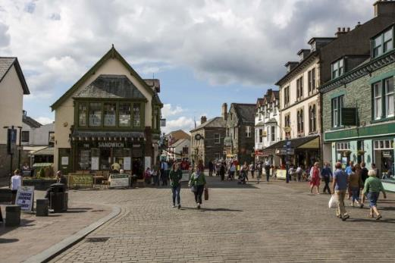
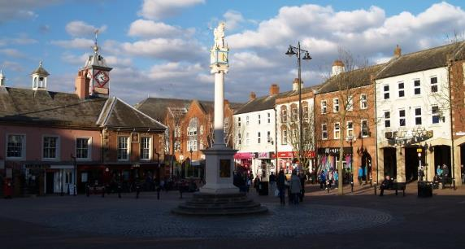

Slide 11
Daily schedule
8.00 Breakfast
7.45-9.30 Make packed lunches
9.30 Teaching followed by fieldwork
3.30-5.00 Follow up work
6.00 Evening meal
7.00-8.30 (approx) Follow-up work
10.30 In rooms
11.00 Lights out/quiet
Please can students be at the bus turning circle for 8.15 so we can leave promptly on the Monday. We aim to return 5.30pm.

Slide 12
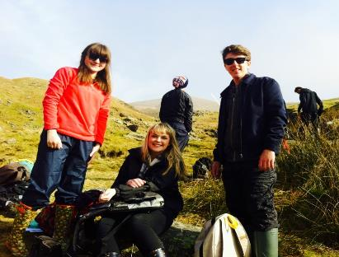
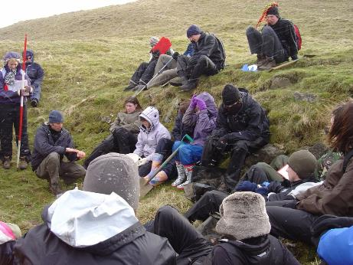
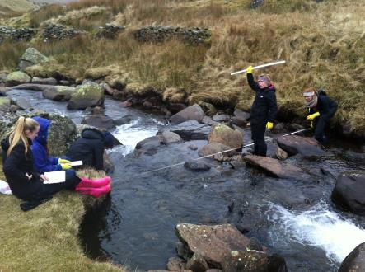
Contrasting weather on the field course. All photographs were taken in March
This is why it pays not to take chances with clothing. Too much is better than too little. Bring it, hire or borrow it!

Slide 13
Important information
The order of days and location of study sites may be varied due to the weather, and to avoid equipment/transport clashes.
Students are requested to bring a pen, pencil and paper. They may also find a camera, memory stick, calculator, protractor, folder in which to keep their work, colouring pencils and graph paper useful.
Students will undertake activities outdoors for extended periods of time and should therefore be dressed appropriately for the weather conditions. They will need a rucksack, walking boots with ankle support, wellies, a waterproof jacket with hood and waterproof trousers. If students don’t own these items, they can hire these from the centre upon arrival .

Slide 14
Suggested equipment
Layers of clothing to suit variable weather
Towels
NO bedlinen needed
Trousers which dry easily (not jeans)
Waterproof jackets and trousers
Walking boots (can be hired for free)
Wellies (for rivers study)
Camera/phone
Relevant textbooks and stationery
A football or games for the evening, table tennis balls, money for pool etc.
Money for Carlisle optional (only £20-30)

Slide 15
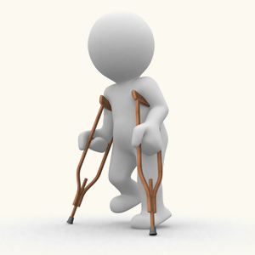
Health and safety
The most important thing for students to remember is that we will be in a fairly remote area so any trip to hospital is a major concern. It needs to be avoided.
Think first!

Slide 16
Health and safety: GURS
Appendix 3.2: Groups Under Remote Supervision (GURS)
On some FSC courses, there may be a desire to remotely supervise groups. This approach as part of the organised educational experience, enables the group to have the broadest experience, collect more or independent data, visit more sites and by doing so, develop their own personal skills. Examples of where this may occur include Geography NEAs, Duke of Edinburgh Award and navigation exercises. FSC has a set of procedures to follow when working with GURS including:
Participants are fully briefed and equipped, before they carry out their activity.
Sites used with GURS are risk assessed by FSC.
Appropriate support e.g. first aid equipment is provided.
Communication systems are in place including emergency and non-emergency contact.

Slide 17
Rules/sharing with other schools
Drugs and alcohol are not permitted in the centre
Climbing is not allowed on any of the rock faces on the estate
Smoking is not allowed onsite
Respect other centre visitors and staff
Follow the country code
No aerosols
Students will be sent home by the centre if they break these rules (see behaviour form).

Slide 18
Notes from past students:
Make sure you get work for other subjects beforehand as it’s a big job to catch up.
Bring table tennis balls and money for pool table.
Bring crisp/chocolate for pack up and money for food in Carlisle.
Bring a lunch box/drinks bottle.
Don’t bring a handbag or expensive clothes as chances are they will be ruined!
Enjoy it because it’s a really good opportunity.
Make sure you take your notes home with you….

Slide 19
Thank you!

